Slide 1
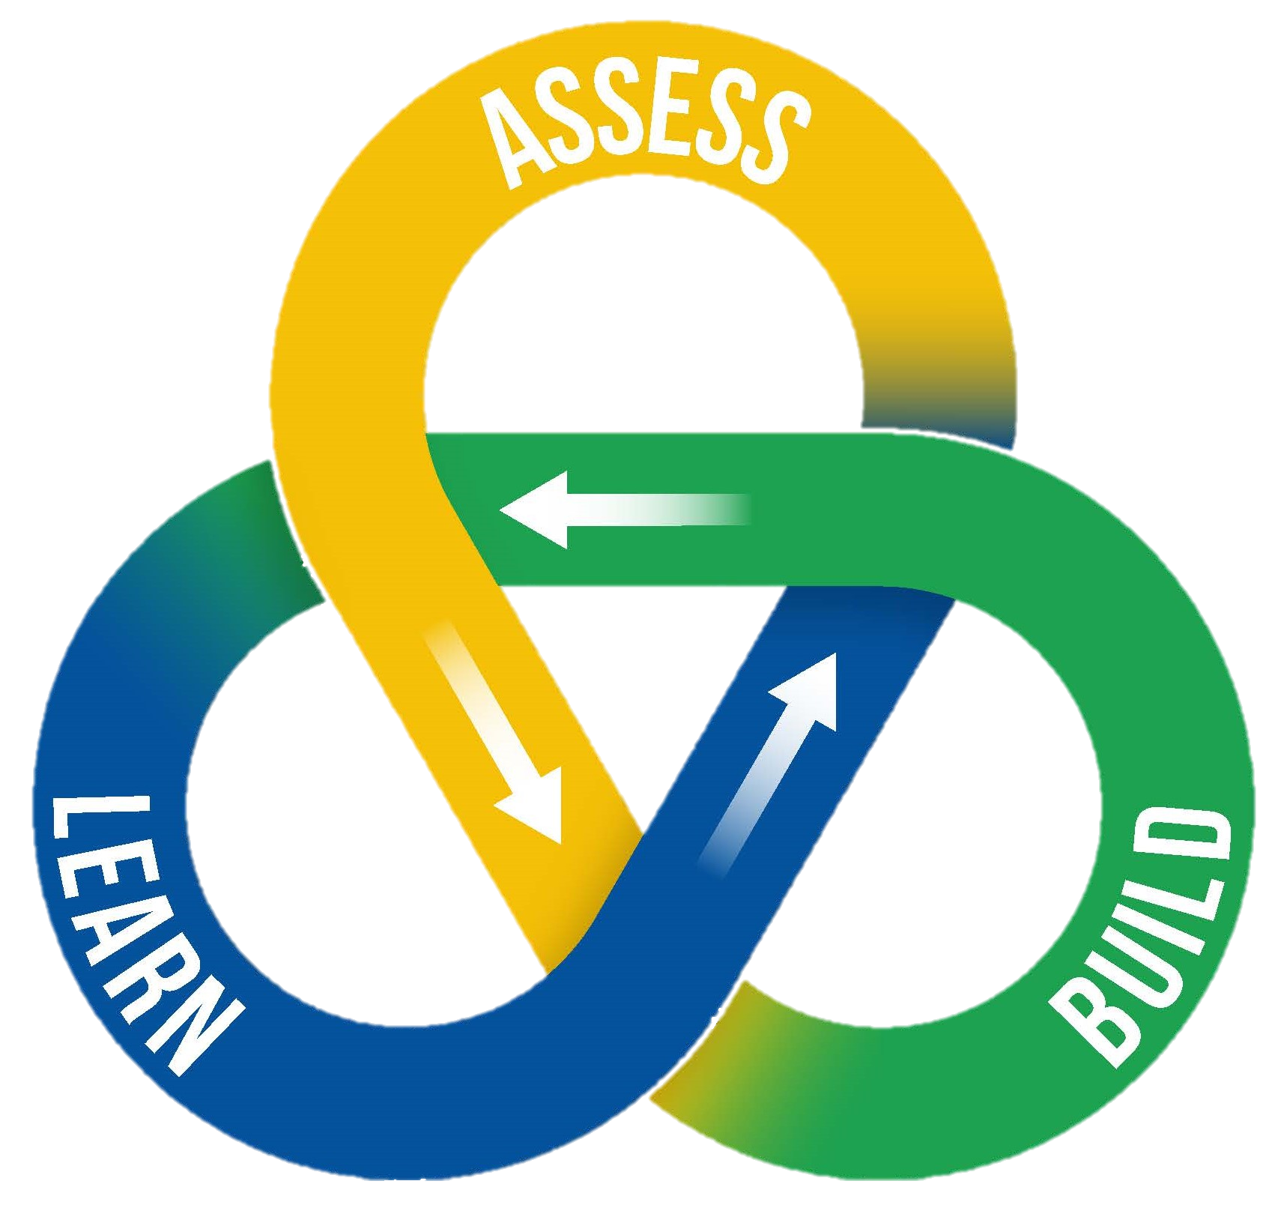
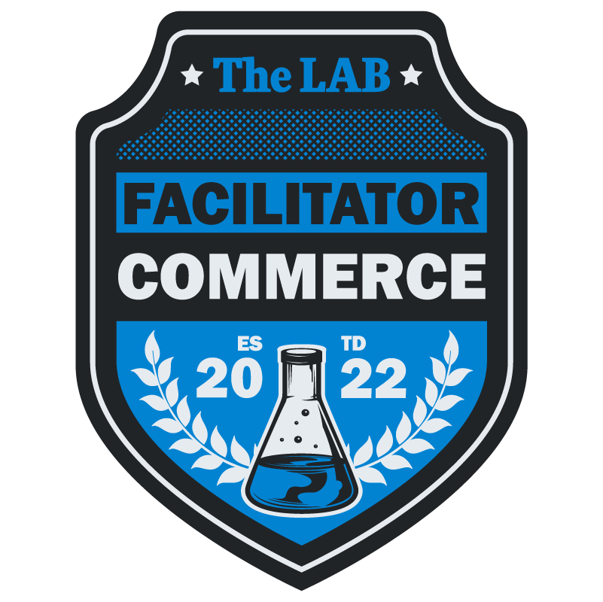
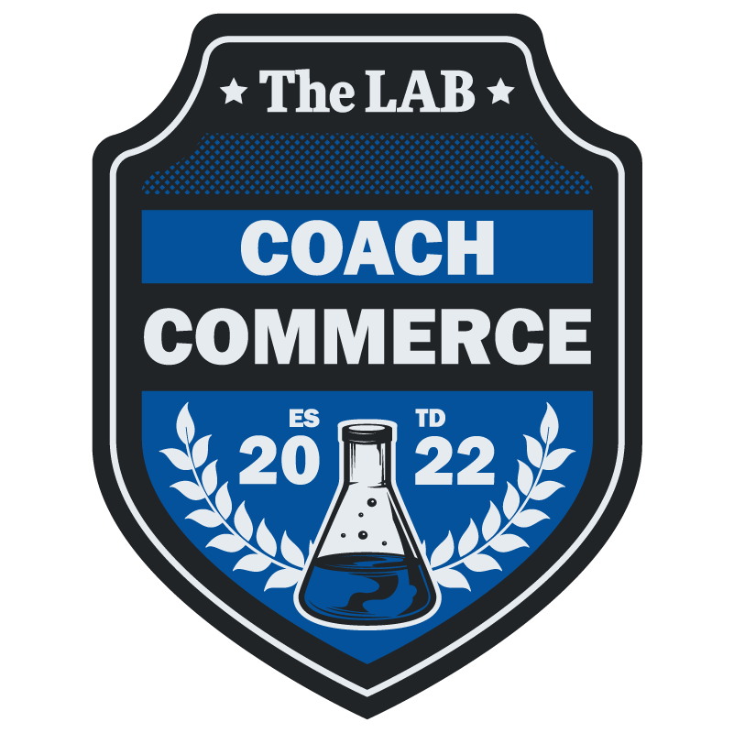
The LAB
Badging Program
FY25 Refresh

Slide 2
Badging Program Overview
What are Innovative Techniques?
Program Framework
Changes
Available Badges
2

Slide 3
What are Innovative Techniques? *Here are some examples:
Oral presentation
Technical demo/challenge
Confidence Ratings
Down-Select
Comparative Evaluation
Select-Best-Suited then Negotiate
Streamlined task ordering procedures
Affordability
HTRO-RP
On-the-Spot Consensus Evaluation
Your Own Innovative Technique!!
*Any technique from the Periodic Table of Acquisition Innovations is permissible for credentialing. We recommend reviewing the PTAI PDF Playbook for ideas. The list above are some of the most commonly used techniques within the Department.
3

Slide 4
Program Framework
The Program is run by The LAB and issues badges and tracks all badge holders, their Bureau, the training information that resulted in a badge, and the type of badge issued
Open to Department of Commerce employees, including Bureaus
Submit an email to TheLab@doc.gov, indicating which badge is requested with supporting documentation
The LAB team verifies information and will issue a badge, as appropriate, or follow up for more information
Badging Program may be changed or revised as needed
4

Slide 5
*Changes from pre-FY25 Badge Program
The program has been simplified and streamlined to grow the community, attract new participants, and better interconnect and incentivize the badge holders
The structure created a very high bar for someone to become a coach and offered little incentive to get further levels of each
The program stagnated and required a refresh
Badge Type | Pre-FY25 Levels | FY25 Levels | Notable Changes
Innovator | 3 | 1 | Allows multiple pathways to get the badge while streamlining its issuance
Coach | 3 | 1 | Focuses on creating a community, lowering the entry barrier
Facilitator | 0 | 1 | New. Tied to hands on training from The LAB via the CLAWs
Inventor | 1 | 1 | Expands the possibilities while removing the voting component
5
*This slide is for informational leadership briefing purposes and can be removed before public posting.

Slide 6
INNOVATOR
*Complete a course on innovation, such as FAR Flexibilities (FCN 170), DHS PIL Boot Camp (FCL-A-9053) or equivalent training, or
Submit an email to TheLab@doc.gov, sharing a story using three or more of the innovative techniques found in the Periodic Table of Acquisition Innovations, or
* Complete a Commerce LAB Acquisition Workshop (CLAW)
*Once an individual completes either of the trainings in the table and receives their CLPs, then they will automatically be issued an Innovator Badge by The LAB if they didn’t already hold one.
There is no required job series to obtain an Innovator Badge.
6

Slide 7
FACILITATOR
Hold an Innovator, Coach, or Inventor Badge, and
Complete a CLAW while serving as a Facilitator, and
Submit an email to TheLab@doc.gov, sharing experience serving as the primary facilitator of one or more of the following: JAM sessions On-the-spot Consensus Evaluations Industry day or related conference
Anyone in the acquisition process with various titles such as COR, PM, CO, CS, Legal, Policy and others who take part in requirement building, evaluation, or award document review of the acquisition process are highly encouraged to pursue the Facilitator badge. Diversity in functional areas will create a more meaningful program and enrich it with truly new perspectives and content.
7

Slide 8
COACH
Hold an Innovator, Facilitator, or Inventor Badge, and
Complete DHS PIL Coaching Clinic or CLAW, and
Submit an email to TheLab@doc.gov, sharing an example using three or more of the innovative techniques found in the Periodic Table of Acquisition Innovations on a Commerce procurement. Examples can be in the form of a Procurement Innovation Narrative (PIN), webinar, short video training, articles, tip sheets, or guides.
The Coaching Badge is intended primarily for Contracting Officers and Contract Specialists, but also extends to any other role in the 1101 or 1102 job series. Others are not excluded, however please indicate your role and the applicability of this badge upon submission.
8

Slide 9
INVENTOR
Create a new-to-DOC acquisition community technique, streamlined process, or tool/resource, or
*Implement an innovative technique developed by The LAB or another entity, but has not yet been tested,
Submit an email to TheLab@doc.gov, sharing the practical application of the process, tool, or technique invented. Examples can be in the form of a Procurement Innovation Narrative (PIN), webinar, short video training, articles, tip sheets, or guides.
*Please reach out to The LAB for examples
Anyone in the acquisition process with various titles such as COR, PM, CO, CS, Legal, Policy and others who take part in requirement building, evaluation, or award document review of the acquisition process are highly encouraged to pursue the Inventor badge. Diversity in functional areas will create a more meaningful program and enrich it with truly new perspectives and content.
9

