Slide 1
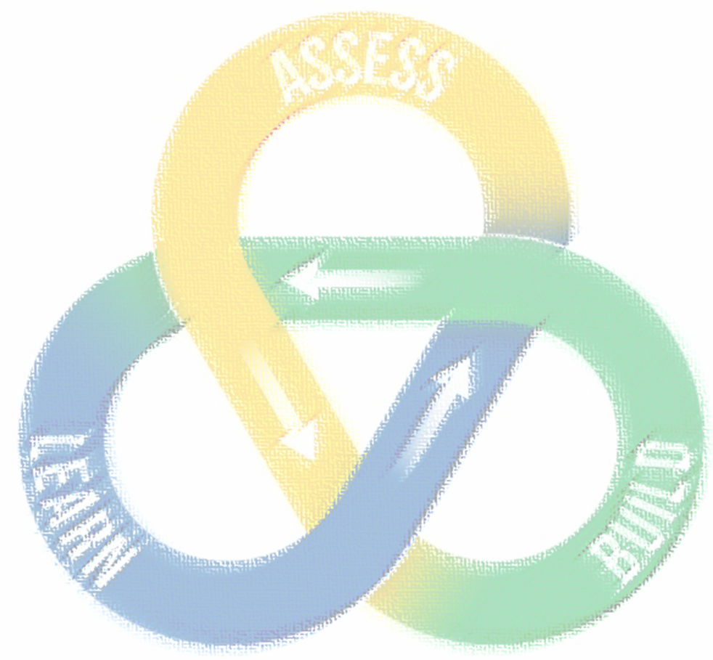
Initial Submission
MS Forms Project Submission link here
Pre-Meet (If necessary)
One on Ones with the Contracting or Program Lead (often the submitter).
Kickoff Session
All members of the IPT attend to establish cadence of sprints, share more about their requirement, gain trust and commitment from each other, and learn more about The LAB and innovation.
Biweekly Sprints
Document Reviews
The LAB acts as an advisory reviewer drawing from its vast experience with formal review comments, especially considering other lines of business, from other procurements to proactively ensure risk is mitigated.
JAM Sessions
All members of the IPT attend sessions designed to engage stakeholders from various disciplines to explore innovative approaches, finalize requirements and acquisition strategy, and tailor their evaluation criteria.
15-30 minutes
Discuss accomplishments, goals, and obstacles
Facilitation Services
The LAB both facilitates and conducts training on facilitation through its requirements workshops to ensure procurement teams move towards the next milestone and to help educate those wishing to fill the facilitator role.
Evaluation Training
The LAB conducts training for the evaluation team to properly apply innovative techniques related to evaluations such as on-the-spot consensus, bulleted eval reports, orals, down-selects, and confidence ratings.
Award Document Support
The LAB has served 100s of teams to help ensure documentation reflects the transparency and compliance with the solicitation and use of all innovative techniques, as well as fundamental contracting principles, appropriately.
Can be weekly, biweekly (standard), triweekly, or monthly depending on your needs.
Or email TheLAB@doc.gov
Could include level above personnel as well.

