Slide 1
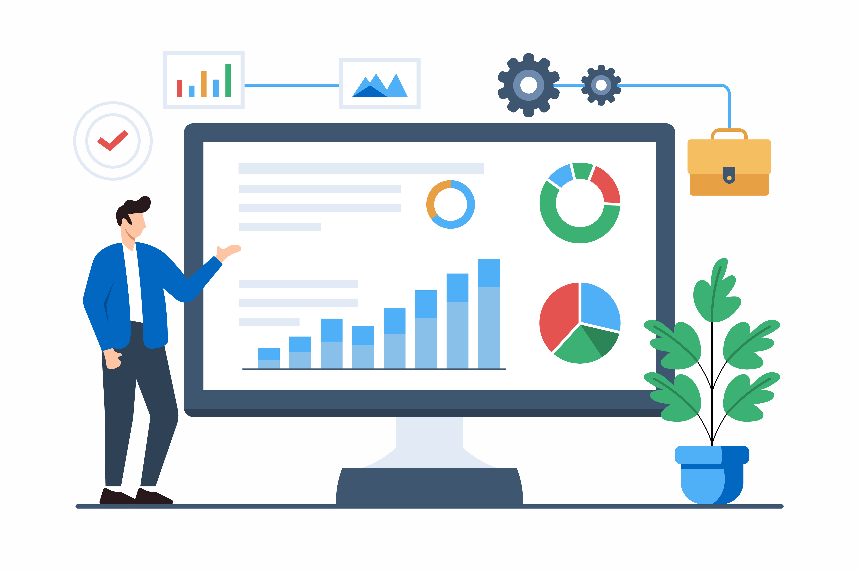

Procurement Innovation & Data
Trevor Wagner
Director of The Lab
Industry Liaison
US Dept. of Commerce
May 22, 2024
Govwide AIA Council Meeting
Slide 1

Slide 2
About this Presentation - Disclaimer
**This presentation was provided to the Office of Federal Procurement Policy’s (OFPP) Governmentwide Acquisition Innovation Advocate (AIA) Council in May 2024. The purpose of the presentation, and information contained within it, was to share with the AIA Council how The Lab is collecting data from its coached procurement projects. Also included is what type of data is being collected, so that other labs or similar entities can start collecting data as their lab is growing and provide procurement coaching to other acquisition teams. The slides show how the data was originally collected in an excel spreadsheet, then pushed to a Microsoft List (in SharePoint), then ultimately as a Semantic model in Microsoft’s PowerBI. These tools are often available to most Government agencies. The PowerBI model for The LAB’s Project Dashboard allows The LAB to better collect, analyze, and visualize data across all the acquisition teams being coached. The sample data of the images within it are samples of projects as of May 2024, however financial information has been redacted.**
Slide 2

Slide 3
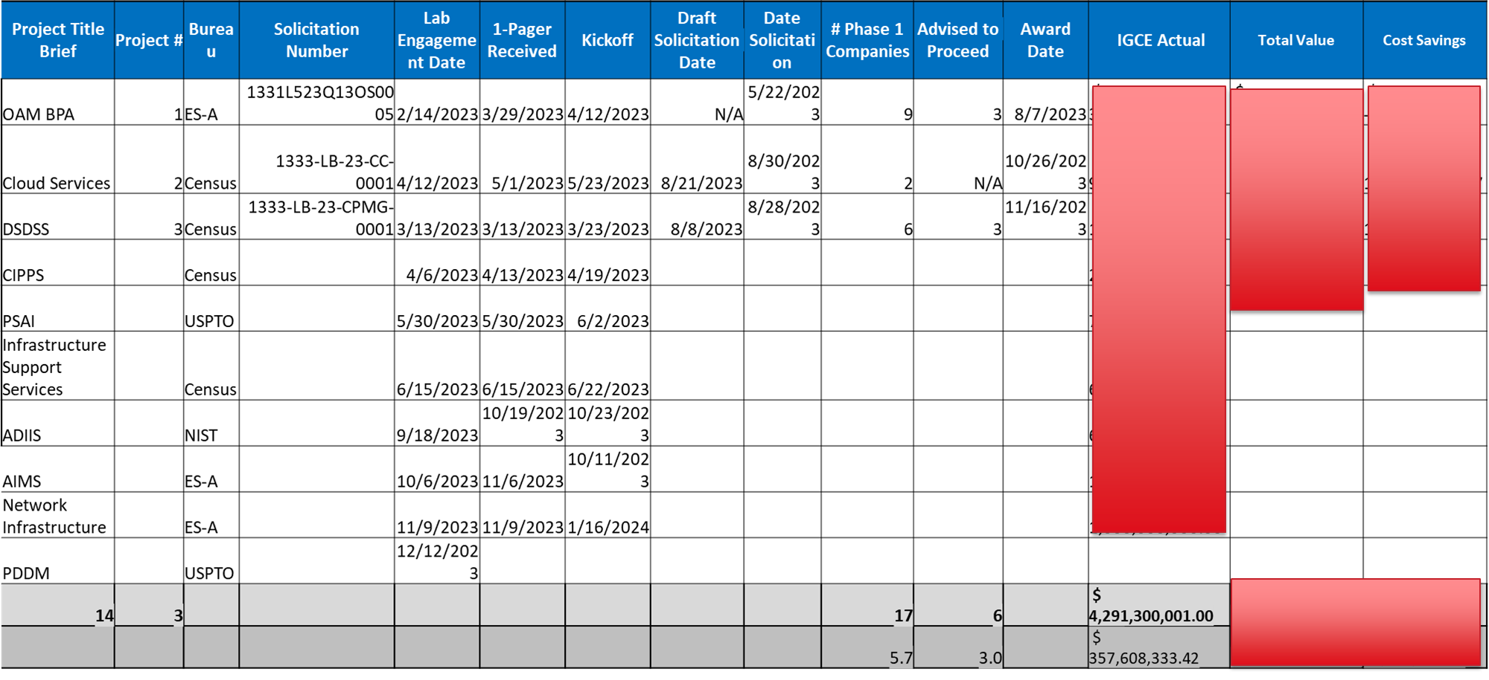
From Excel…
Slide 3

Slide 4
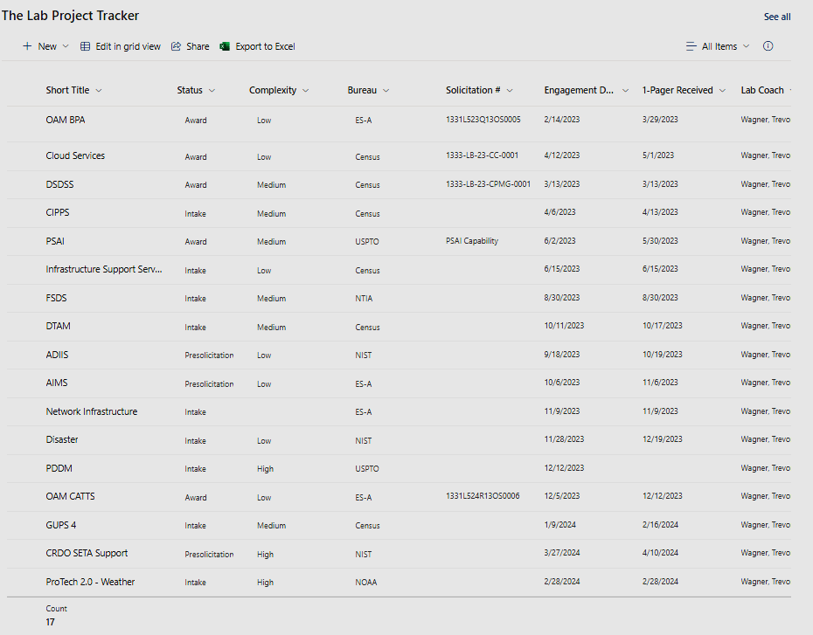
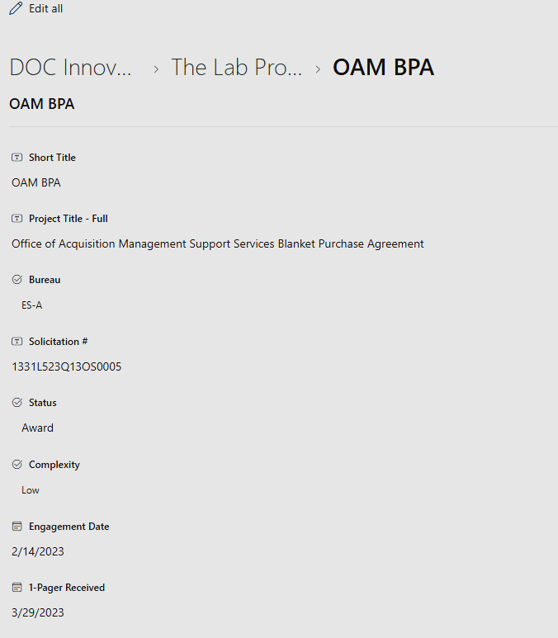
…to Microsoft/SharePoint Lists
List View
Project View
Slide 4

Slide 5
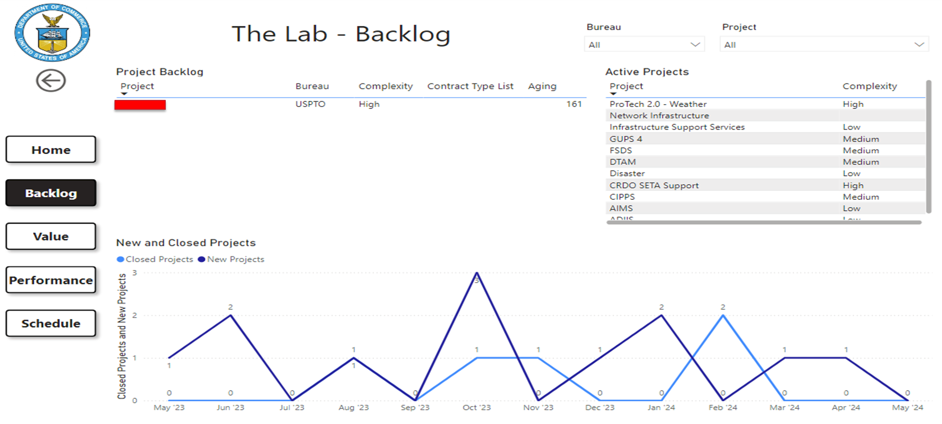
…to PowerBI Dashboard
Slide 5

Slide 6
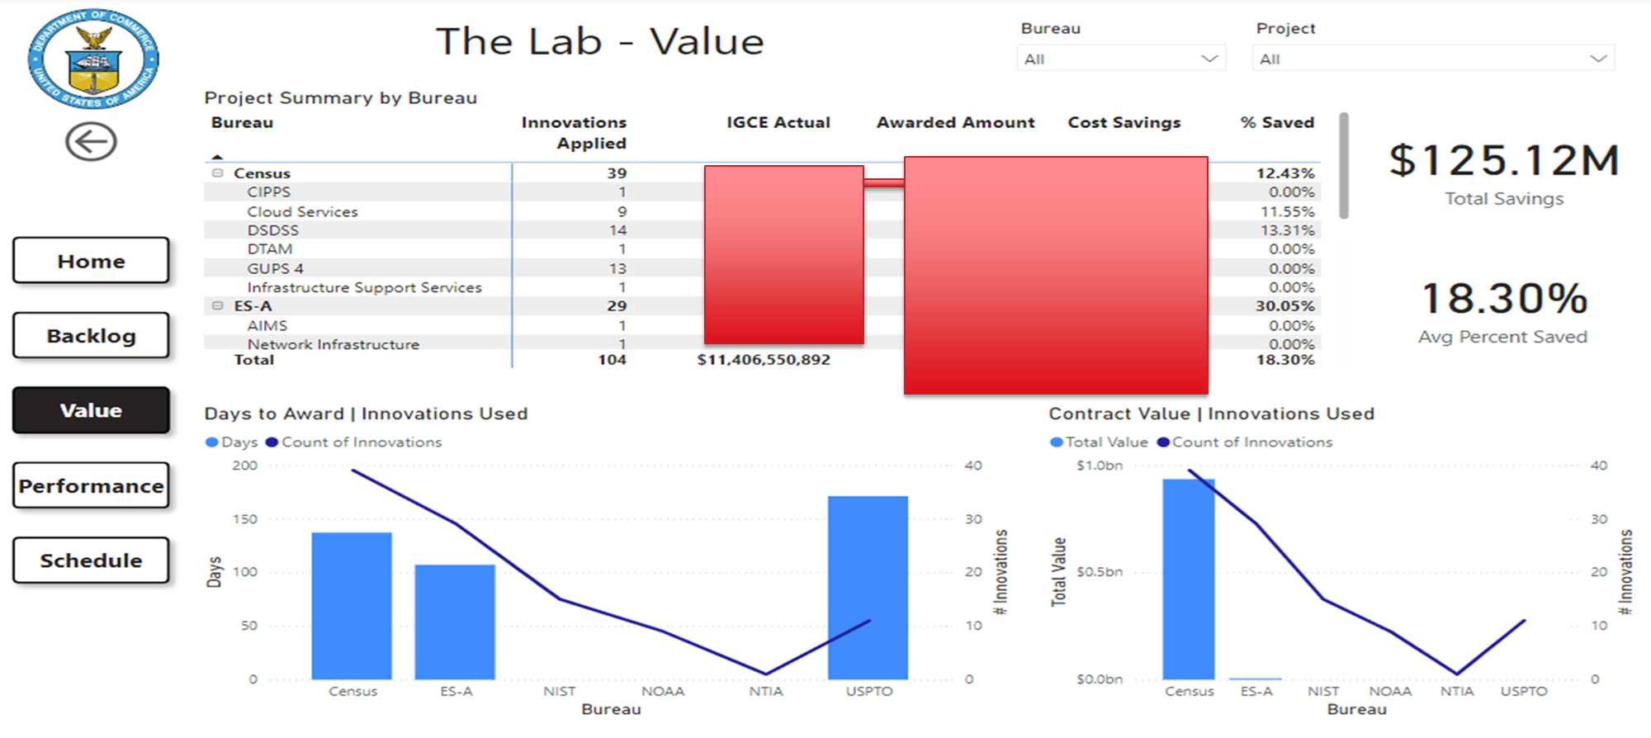
Value
Slide 6

Slide 7
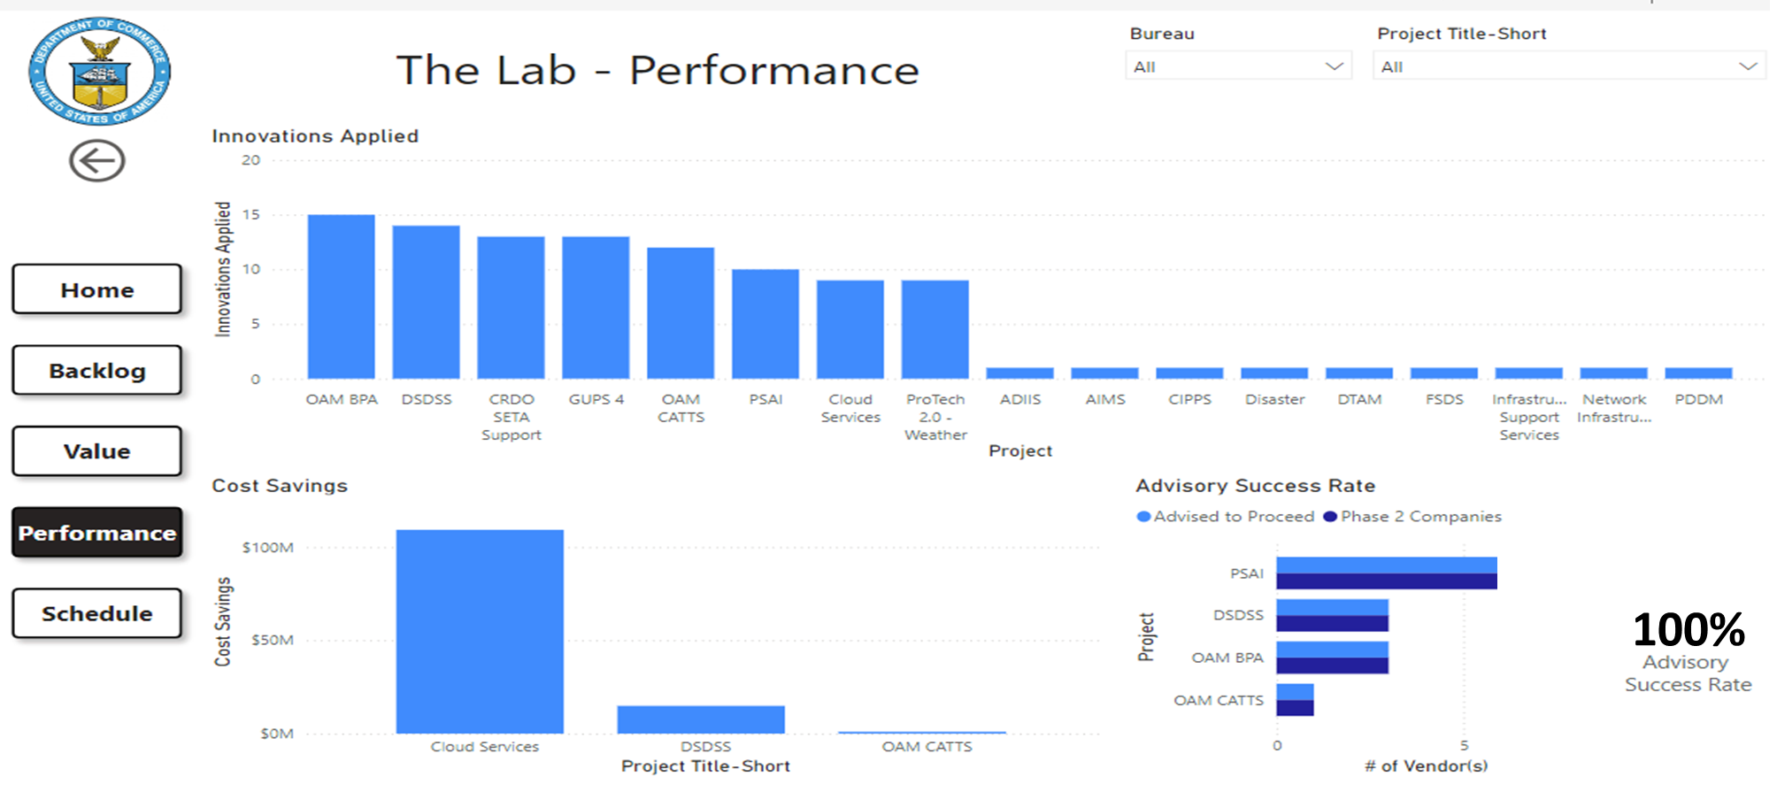
Performance
Slide 7

Slide 8
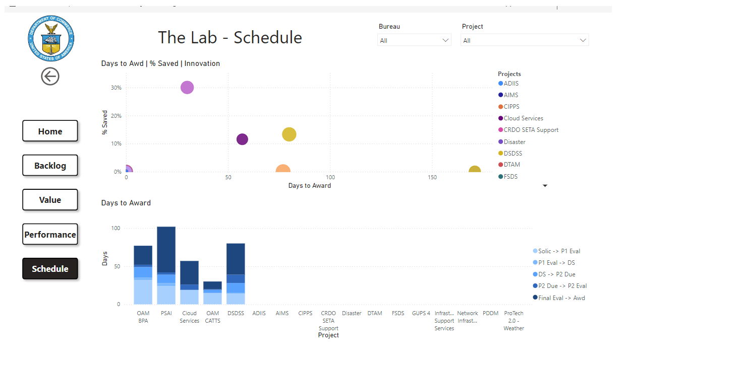
Schedule
Slide 8

Slide 9
Data Points Captured
Days - Notice to Phase 2 Due Date
Phase 2 Due to Phase 2 Evals
Phase 2 Evals Complete to Award
Days Solicitation to Award
Total Hours Spent in Training & Evaluations
ARB [Bureau/Approved/Conditions]
AP [Bureau/Approved/Conditions]
Special Interest [Y/N]
"Brief Explanation/Debriefings"
Informal Feedback Sessions
Protests
Protest Forum
Protest Date
Protest Resolved Date
Protest Delay Timeline
Vendor Feedback
# of Innovations
Innovations
Phase 2 Due Date
Phase 2 Tech Evals Date
Down Select Date #2
# Phase 3 Companies
Phase 3 Due Date
Phase 3 Tech Evals Date
Award Date
IGCE Actual
Total Value
Cost Savings
% Saved
FAR Section
SBSA [Y/N/Partial]
Contract Type [T&M/Cost/FFP/etc.]
BPA/IDIQ [TO/Contract//BPA/etc.]
Days - Solic. To Phase 1 Evals
Days - Phase 1 Due to Evals Complete
Days - Phase 1 Evals Complete to Notice
Days - Solicitation to Phase 2 Due
Project Title Full
Project Title Brief
Project #
Bureau
Solicitation Number
Lab Engagement Date
1-Pager Received Date
Kickoff Date
Draft Solicitation Date
Date Solicitation Released
# Phase 1 Companies
# Advised to Proceed
# Advised Not to Proceed
# Proceeded
Phase 1 Due Date
Date Phase 1 Tech Evals
Down Select Date
# Phase 2 Companies
Phase 2 Due Date
Slide 9

Slide 10
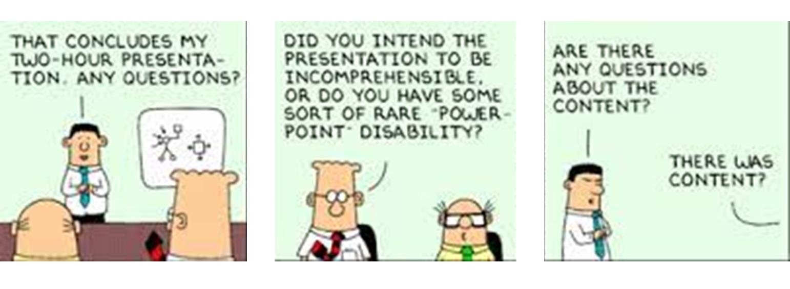

Questions
LAB email: TheLab@doc.gov
Trevor Wagner: TWagner@doc.gov
202-641-5940
Heather Thomas: HThomas@doc.gov
Lab Website: https://www.commerce.gov/oam/lab
Slide 10

