Slide 1

GovTA Overview
January 19, 2023

Slide 2
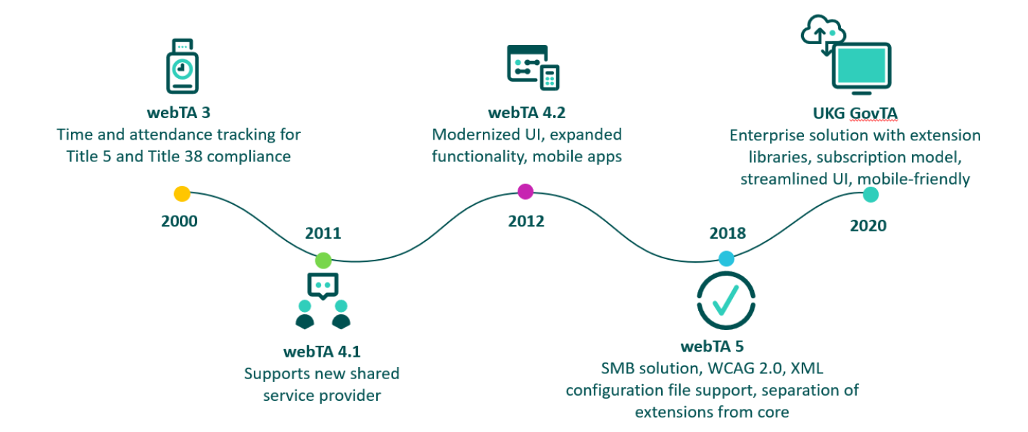
Background
In February 2021 the webTA vendor, Kronos/UKG, announced end of engineering support for webTA version 4 on September 30, 2022
End of Engineering Support includes discontinuation of new releases, service packs, patches, bug fixes, and security updates
Kronos/UKG will not upgrade current version 4 customers to version 5 and must upgrade to GovTA

Slide 3
Contract Award
GovTA is the next iteration of webTA, with a new user interface and some enhanced features
UKG will maintain our current webTA version 4 until successful transition to our new system even after end-of-engineering support (includes security patching, continuity of operations, and federal time-keeping mandates, but no additional enhancements or code changes)
Contract was awarded to LenTech, a UKG partner, reseller, and hosting provider for webTA and GovTA, in November 2021
LenTech will provide cloud hosting services for GovTA
All historical data will be migrated (6+ years)

Slide 4
Implementation Details
GovTA is expected to include customized extensions and bug fixes previously requested by DOC.
GovTA Bi-Directional Connectivity with NFC is possible, but more detailed requirements needed, with process to begin after GovTA deployment
BAS Accounting Codes – the ability to use BAS Account Structure updates will be ready when needed, after initial software deployment date
Web based training provided
Outreach sessions will continue throughout the project
Please email CSC-GovTAPMO@doc.gov with any questions

Slide 5
Project Updates
GovTA Cloud Environment Built
UKG delivered software 12/23/2022 and Lentech installed in their Cloud environment 01/11/2023
Security Tasks
  Authority To Test (ATT) received from CISO 11/30/2023. Expires 05/30/2023
  Authority To Operate (ATO) process underway. Scheduled to be completed May 2023
  Interconnection Security Agreements (ISA) and Memorandums of Understanding (MOU) underway and scheduled to be completed by February 2023

Slide 6
Project Updates (cont’d)
Testing Plan being finalized and will be communicated when ready
  Testers being requested from Bureaus
  Testing meeting to be scheduled next week
  Testing scheduled for 02/06 – 03/02/2023
Training Plan being finalized and will be communicated when ready
UKG provided the below link for Core Training Videos
https://edhosting.ukg.com/UA/public_sector/GovTA_Core/GovTA_Core_Videos/story.html
Please copy and paste link into your internet browser if needed
These videos cover an overview of GovTA, plus the most commonly used functions for:
  Employees
  Timekeepers
  Supervisors
  HR Administrators

Slide 7
Key Milestones
Milestone | Estimated Date | Notes
GovTA software delivery (includes customizations) | December 2022 – January 2023 | Software delivered 12/23/2022 Software installed 01/11/2023
Testing | February 2023-March 2023 | Estimate based on software delivery date
Training | April-May 2023 | Estimate based on software delivery date and includes web-based training.
ATO | April-May 2023 | Estimate based on current schedule
Production Implementation | June 2023 | Estimate based on current schedule

