Slide 1

Travel Management Division (TMD) Town Hall Presentation
Office of Financial Management
Office of Financial Reporting, Internal Controls, and Travel (OFRICT)
Travel Management Division
Date: June 15, 2022

Slide 2
TMD Operating Hours
The Travel Management Division (TMD) hours of operation are Monday through Friday from 9:00 am – 3:30 pm.
For Passport/Visa appointments email: OFM-DOCPassportVisaHelpdesk@doc.gov

Slide 3
Central Mailbox Use
Travel Management Division (TMD) central mailboxes:
Direct Travel Policy questions to: OFM-DOCTravelPolicyHelpdesk@doc.gov
Direct Travel Card Program questions to: OFM-DOCTravelCardProgram@doc.gov
Direct Conference Policy questions, pre-approval, and reporting submissions to: DOCConferences@doc.gov
Direct Premium Travel questions to: OFM-DOCPremiumTravelHelpdesk@doc.gov
Direct Passport and Visa questions to: OFM-DOCPassportVisaHelpdesk@doc.gov

Slide 4
Senior Travel Official (STO) Packages

Slide 5
Senior Travel Official (STO) Training
Travel Training
Travel Authorizations Key Points
Senior Travel Official Authorization and Voucher Package Preparation
Approval of travel documents
Amendments to Travel Authorizations
Cancelation of Travel
Military Aircraft (Mil-Air) Transportation

Slide 6
Senior Travel Official (STO) Training (Continued)
Objective/Background
Packages for Bureau Heads are required to be completed for review by the Department to ensure travel is within DOC policy, conducted in the most effective, efficient manner, and only when necessary to accomplish the mission of the Government.
STO Approving Official Responsibilities
Must have knowledge of employee’s travel activities
Approve the obligation of funds and the validity of all travel expenses

Slide 7
Senior Travel Official (STO) Overview
Serve as the final approver on the travel
They must ensure:
The claim is properly prepared.
The types of expenses claimed are authorized and allowable expenses.
The amounts claimed are accurate and within prescribed rates.
Receipts for expenses over $75, all applicable receipts are scanned into E2 and submitted with the travel voucher for reimbursement.

Slide 8
Travel Training Requirements
Travel Policy Training
Commerce Learning Center (CLC)
Travel Basics
Fly America Act
Approving Official
E2 Solutions Training
E2 training materials are located on the website –https://e2.gov.cwtsatotravel.com/ThinkCAP/e2/login?execution=e1s1
Ad-hoc Training on package preparation available by TMD
STO
PCT

Slide 9
Travel Authorization Key Points
Key Points
Travel Authorizations are the “backbone” of the travel process.
The Travel Authorization lists all pertinent information about the trip and what will be allowed to be claimed on the voucher.
The amounts used are estimates but should be as accurate as possible.
Prudent Person Rule
Federal Travel Regulation (FTR) §301-2.3 - You must exercise the same care in incurring expenses that a prudent person would exercise if traveling on personal business.
Notes:
I

Slide 10
Travel Authorization
Authorization Checklist
Verify if the trip is necessary
Itinerary: Dates to and from destinations
Trip Information: Type purpose and destination
Reservations: Find cheapest authorized travel
Provide appropriate justifications
Ensure Travel Authorization is in STO queue

Slide 11
STO Package Authorization Preparation
Documents required for processing STO Travel Authorization packages:
Travel Authorization Packages for Travel Management Division (TMD) to review
and approve contents.
Memo for the Chief Financial Officer and Assistant Secretary for Administration (CFO/ASA) or designee
Travel Authorization
CWTSato Travel Itinerary with appropriate justifications
Hotel Information if outside of Travel Management Center (TMC) and/or not on the CWTSato Travel itinerary provide copy to TMD
Detailed Travel Agenda/Scheduling Information

Slide 12
STO Package Authorization Preparation
Include all necessary justifications as per the Federal Travel Regulation (FTR)
OGC Ethics Review
Any other additional supporting documentation
Note: Please follow and ensure the documents for DOC Post COVID-19 internal travel requirements are included.

Slide 13
Airfare
GSA City Pair contracted flights CA vs. YCA
Travelers are encouraged to book their flights early in order to utilize CA fares. YCA fares are not as cost effective, but they are a Government fare that must be used when CA fares are not available.
Saves money, allows budgeting, refundable tickets, no blackout periods, and last seat.
When no contract fare is available, you must use the lowest cost service, unless your agency determines that the use of a higher cost service is more advantageous.

Slide 14
Airfare
Any additional costs or penalties incurred by the traveler resulting from unauthorized use of non-contract service are borne by you.
Personal use of contract fare not allowed.
Contract fares are only applicable to official Temporary Duty Travel (TDY) and may not be used for any personal travel taken in conjunction with the official business trip.

Slide 15
Lodging & Rental Car
Lodging
Special circumstances – Authorizing Officials (AO’s) can approve up to 300% over lodging portion of per diem rate
Provide justification
Approval must be before travel occurs
No lodging reimbursement when staying with friends, and relatives
Rental Car
Reimbursable rental car expenses.
Rental price, taxes, local assessments, and gas.

Slide 16
Amendments to Travel Authorizations
Amendments must be prepared if one or more of the following circumstances occur:
For travelers deployed in E2, the amendment process will be based on the configuration of E2 Solutions.
Travel costs will be materially affected ($250 or more).
There are changes to the itinerary.
Required justifications need to be added.

Slide 17
Travel Authorization Memo

Slide 18
Cost Comparison Worksheet Official Travel to or from Alternate Location

Slide 19
STO Package Voucher Preparation
Documents Needed for processing STO Travel Voucher packages: Documents should be processed by Bureau prior to providing it to TMD. Incomplete packages will be returned for corrections.
TMD Internal Review
Memo for the STO, Julie Tao, Director, Office of Financial Reporting, Internal Controls and Travel (OFRICT) or designee. (Please ensure the cost on the memo matches the Travel Authorization Grand Total)
E2 Travel Voucher
All applicable receipts
All necessary justifications as per the FTR
Any other additional supporting documentation

Slide 20
Travel Vouchers
Vouchers
FTR §301-52.7 - When must I submit my travel claim?
Unless your agency administratively requires you to submit your travel claim within a shorter timeframe, you must submit your travel claim as follows (Same as FTR):
Within 5 working days after you complete your trip or period of travel; or
Every 30 days if you are on continuous travel status.
Use local vouchers for travel in Permanent Duty Station.
Always update voucher with actual expenses.
Approving Official signature certifies travel was taken, charges are reasonable, and approves reimbursement.

Slide 21
Travel Vouchers
Receipts
Airfare rail transportation, rental car, lodging (itemized) expenses over $75.00 other expenses as required
Common issues with/on vouchers
Not legible, receipts not attached to voucher
Receipts must show actual amount paid
Receipts Required
Airfare
Rental Car
Lodging
Expenses over $75.00 (as required)

Slide 22
Travel Voucher Check List
Verify expenses are valid
Verify expense amounts and dates
Per diem, lodging, transportation costs, and Commercial Ticket Office (CTO) fees
CONUS – taxes (are separated), parking, etc.
OCONUS – taxes included with lodging cost
When traveler stays in more expensive room without approval,
justification is required after the fact
Receipts are attached
Voucher amounts and dates must match receipts

Slide 23
Local Travel Vouchers
Local vouchers
Expenses incurred in and around local travel.
Local Travel
Travel within a 50-mile radius of the official duty station that is performed wholly within one day and does not involve an overnight stop or per diem claim.
Entitlement
No entitlement to employee for per diem or other subsistence allowances.
Unless travel to recurring worksite that is greater than 50 miles, as long as the travel status (from point A to point B back to point A) does not require:
Travel status that exceeds 12 hours (in this case meals and incidentals
are authorized);
Lodging; and
Use of a rental vehicle

Slide 24
Meals and Incidental Expenses (M&IE)
Meals and Incidental Expenses
First and last day – 75% of the rate
All other days – authorized rate unless meals provided
Provided – Government purchased meals such as in a conference/registration fee or meeting
Complementary – on flights, in hotels; traveler receives full M&IE rate
Incidental Expenses:
Designed to cover small out-of-pocket costs
Received by traveler even if meals provided

Slide 25
Vouchers
Vouchers
Vouchers record money spent during travel
Two types of vouchers:
TDY Vouchers
Expenses incurred during travel
Create a voucher from an authorization
Trip dates, length, locations
Expenses; adjust lodging per diem as applicable

Slide 26
Vouchers
Claim reimbursement once for expense
Include ATM fees if Traveler with Government Travel Charge Card (GTCC) used
CTO fees
Traveler responsible for data on voucher
Additional documentation
AO may request additional receipts or documentation.
Unused tickets must be returned to CWTSato travel
Ensure change of flight fees are added to voucher, not duplicated.

Slide 27
Voucher Memo

Slide 28
Leave while on TDY
Reimbursement for per diem or actual expenses on leave or non-workdays while on official travel
Personal leave must be authorized on travel order.
If travel status requires stay to include a non-workday and not for the convenience of the traveler.
Agency determines reimbursement for non-workdays when leave is taken immediately before or after non-workdays.
Traveler may not claim per diem for any day that four hours of leave is used except for emergency sick leave.

Slide 29
Methods of Payments
GTCC and Traveler without
Centrally Billed Accounts (CBA)
CBA: For travelers without GTCC
Reimbursement responsibility of Government, non-reimbursable to traveler
Individually Billed Account (IBA)
Payment is responsibility of card holder even if they have not been reimbursed by the servicing finance office. Should only be used:
By traveler only
While on official travel only
Pay for Travel-Related expenses like lodging, rental car, and meals
ATM advances

Slide 30
Verbal Orders, Post approvals, Queue, & Roles
Verbal Orders- (Also known by some as "Short Notice") Mission requirements may dictate the need to deviate from the standard process of using E-2. While we would like to utilize E-2 at the fullest capacity, TMD understands unforeseen circumstances do exist. (It is recommended that each Bureau have a process in place to for approval of emergency orders).
The following individuals are only authorized to approve verbal orders at CWTSato Travel: Steve Kunze, Julie Tao, Cecelia Kizer and Vernita Tyler- Brown.
Post-Approvals- After travel, expenses that were not authorized on the "initial" travel authorization are considered post-approved. While post-approvals happen, we prefer to have the best estimates upfront. Note: Future discussions or system enhancements may include post-approvals happening with the "liquidation/voucher" and away from the "obligation/authorization" instead.

Slide 31
Verbal Orders, Post approvals, Queue, & Roles
Queue- A list of "pending" PCTs/STOs retrieved from E-2 in a definite order, usually the order of insertion.

Slide 32
Verbal Orders, Post approvals, Queue, & Roles (Continued)
Roles - Chief Financial Officer/Assistant Secretary for Administration (CFO/ASA) - Department Organizational Order (DOO) 10-5 authorizes the Chief Financial Officer and Assistant Secretary for Administration (CFO/ASA) to serve as "agency head" under the authorities in 5 U.S.C., Chapter 57 regarding official travel, transportation, and subsistence of the Department employees and other individuals traveling on official business for the Department.
Office of the Secretary (OS) Chief of Staff (COS) or Deputy Chief of Staff (DCOS) - The Chief of Staff is responsible for approving travel authorizations and vouchers for the CFO/ASA, Secretarial Officers, Heads of Departmental Offices, and Heads of Operating Units reporting directly to the Secretary. When the COS is not available, the DCOS is also responsible for approving travel authorizations and vouchers for above-mentioned individuals who report directly to the Secretary.

Slide 33
Verbal Orders, Post approvals, Queue, & Roles (Continued)
Secretarial Officers and Heads of Bureaus/Operating Units - This authority is delegated to Secretarial Officers and heads of Bureaus/Operating Units (as defined in DOO 1-1), to authorize travel for personnel under their supervision. Under Secretaries, Assistant Secretaries, Directors, Chief Financial Officers, Chief Administrative Officers, and other designated key senior management officials are responsible for ensuring compliance with the policies and procedures contained in this Handbook and subsequent internal guidance.
Note: Please ensure that the signed CD-334 is forwarded the same day it's entered into E-2 and/or our Queue.

Slide 34
Premium Class Travel (PCT) Packages

Slide 35
Premium Class Travel (PCT) Packages
Premium Class Travel (PCT)
Regularly scheduled flights between origin/destination points (including connecting points) provide only such accommodations. CFR, Title 41, Chpt. 301, Sub Chpt. B, PART 301-10 - TRANSPORTATION EXPENSES https://www.ecfr.gov/current/title-41/part-301-10
When submitting, remember to check for and/or provide the following info:
CD-334
“Travel Order Number” inserted (Blk. 7)
The correct “Purpose Code” (Blk. 10)
The correct “Travel Exception Code” (Blk. 11)

Slide 36
Premium Class Travel (PCT) Packages (Continued)
Correct “Justification” for (Blk. 13). Note: should align with “Travel Exception Code”
Specify “Business/First” Class (Blk. 15)
Correct “Calculations” in (Blk. 15/16)
Receipts
Break-down of “Foreign Currency”
Post required documents only. Note: refrain from posting the same document more than once.
If required content is missing, the document will be “Recalled”
Please send your packages to TMD central mailbox
Reasonable Accommodation Letter (RAC)
Signatures in assigned places
Contractors are NOT allowed to approve in E-2/call CWTSATO for Verbal Approval

Slide 37
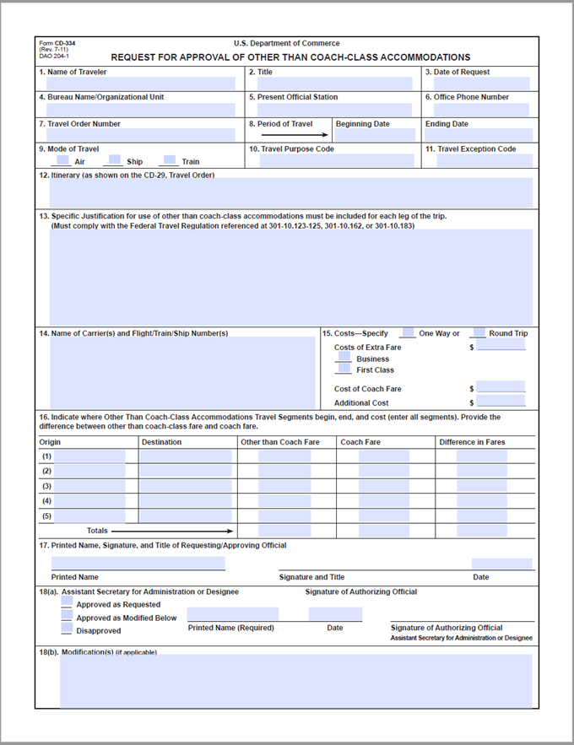
CD-334 Form

Slide 38
Routing List Update and The Ripple Impact

Slide 39
Routing List Update and The Ripple Impact
Collaborating and Communicating with TMD and Coordinating with various helpdesks on the updated Routing, Updating, and In/Out-processing (replacements, changes, back-ups and more).
Schedule a demo of ripple effects (as requested/if needed) when routing pools or other actions are changes without working with helpdesk or testing before publishing or going live.
Work changes to routing pools directly with Cecelia Kizer, Rholondra Louis, and /or Linda Munday as needed until Project is turn back over to Linda Munday’s team (TBD).

Slide 40

APC Digest Information

Slide 41
APC Digest Information
The APC Digest is a distribution to keep the DOC Travel Charge Card community connected regarding program enhancements, policy updates, and best practices.
The APC Digest for June 2022 was disseminated to the A/OPCs on June 7, 2022.

Slide 42
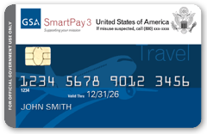
Travel Card (IBA/CBA)
HelpDesk: ofm-doctravelcardprogram@doc.gov

Slide 43
Travel Card (IBA/CBA)
Individually billed accounts (IBAs) are issued to employees to pay for official travel and travel-related expenses. The government reimburses employees for authorized expenses. The employee is responsible for making payment to the bank.
Centrally billed accounts (CBAs) are established by some agencies to pay for official travel expenses. Centrally billed accounts are paid directly by the government to the bank.
What is the benefit for federal agencies? Each agency or organization using the travel charge card receives a rebate based on sales volume. The sale refund is remitted to the organization.
Statistical Data: As of June 1, 2022
Number of IBA cards: 11,314; Total Transaction Amount - $5,989,440.00
Number of CBA cards: 131; Total Transaction Amount - $10,444,940.00
Quarterly Refunds:
FY22 Q1 - $79,686.00
FY22 Q2 - $45,396.00
Total = $125,082.00

Slide 44
GSA SmartPay Virtual Forum
GSA SmartPay Virtual Training Forum – August 2-4, 2022
The 3-day virtual event will feature comprehensive training covering all aspects of how to successfully manage your charge card program.
Who should attend the training forum?
Agency/Organization Program Coordinators (A/OPCs)
Financial Managers
Approving Officials
Billing Officials
Other agency personnel who play a role in managing the Department’s GSA SmartPay charge card program

Slide 45
GSA SmartPay Virtual Forum
This event is not intended for cardholders.
During the 3-day virtual event, GSA will hold scheduled training sessions with the opportunity to chat with presenters. Registrants who are unable to attend the scheduled training sessions will be able to view the courses on-demand through Wednesday, August 31, 2022.
DOC Travel Business Line Day is scheduled for Monday, August 1, 2022.

Slide 46
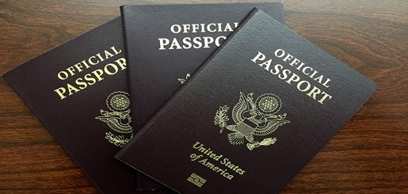
Passport/Visa
Help Desk, OFM-DOCPassportVisaHelpdesk@doc.gov

Slide 47

Agenda
The goal is to provide an overview of the Passport/Visa process
We will:
Provide roles responsibilities for the following
Passport acceptance agents
Travelers
Travel point of contacts
Managers
Review passport forms
Update you on Passport/Visa policy and procedures
Introduce you to the Visa/Passport Database

Slide 48
Authorized Personnel
A passport is one of the most important forms of identification a person can possess. It is important to have a passport if you plan to travel to a different country so that you will be able to prove who you are and where you are from. Since travel security measures have increased it is almost impossible to travel without a passport.
Official passports are issued to Department of Commerce (DOC) official or direct hire employees of the U.S. government traveling abroad to carry out official duties.
A Diplomatic passport is issued to a Foreign Service Officer or to a person having diplomatic status or comparable status because he or she is traveling abroad to carry out diplomatic duties on behalf of the U.S. government. This includes All foreign commercial service personnel dependents assigned to an international post as well.

Slide 49
Authorized Personnel
The Department of State issues one or the other
Cannot have both
Can have more than one official or more than one diplomatic passport
More than one passport can be helpful to frequent travelers
One passport can be used to obtain a visa
Other one is being used to travel with
The Department of State issues one or the other
Cannot have both
Can have more than one official or more than one diplomatic passport

Slide 50
Authorized Personnel (Continued)
More than one passport can be helpful to frequent travelers
One passport can be used to obtain a visa
Other one is being used to travel with

Slide 51
Not Authorized
Contractors or volunteers
NOT authorized official passports.
Must obtain a tourist (regular-fee) passport
Pay the required fees
Must also obtain any necessary visa requirements directly through the embassy of that foreign country
DOC employees who are not U.S. citizens
Must use their passport issued from the foreign country
Must also obtain any necessary visa requirements directly through the embassy of the foreign country that they are visiting

Slide 52
Not Authorized (Continued)
Travelers (Invitational, NIST Fellows) who are not federal employees
Exceptions to NIST Fellows
ARE federal employees
Will be required to submit an SF-52 reflecting their federal status
Note: We do not assist other federal employees in getting passports and visa. Direct those travelers back to their agencies travel office for processing.

Slide 53
Roles and responsibilities for Passport Processing
Check for and examine the following documents:
All supporting documents are included with passport application
(Birth certificate, Identification, recently issued passport, etc.)
One 2x2 photos with a white/off-white background with a clear, front view, of the full face
The applicant must provide all required documents

Slide 54
Roles and responsibilities for Passport Processing
Passport Acceptance Agent and/or Preparer
Check the Letter of Authorization (LOA) which is a memo signed by a DOC approving official authorizing the applicant to apply for the special issuance passport
Is the LOA signed by an official within the Department
Does the LOA contain the required traveler information?
Is the LOA printed on the headquarters letterhead?
If the LOA does not meet the above, the LOA and applicable documents should be returned with an explanation of what needs to be completed to accept the LOA for processing.

Slide 55
Roles and responsibilities for Passport Processing: (Continued)
Passport Acceptance Agent:
Upholding legal responsibilities as an acceptance agent. By signing the passport application, the acceptance agent certifies that:
The applicant has personally appeared before him/her
The applicant has presented ID as documented on the application
The applicant has taken the oath
She/he has personally witnessed the applicant signing the application
She/he has verified that the photo on the identification, the photo submitted with the application, and the applicant’s personal appearance are the same individual
Ensuring that special issuance passport applications are only submitted for eligible individuals.

Slide 56
Roles and responsibilities for Passport Processing: (Continued)
Making passport records available to the Department of State Office of the Inspector General (OIG) for review, monitoring, audit, or investigation. The OIG has the authority to review passport records as specified in the Inspector General Act. All OIG site visits, or record reviews will be arranged in advance with your facility and SIA.

Slide 57
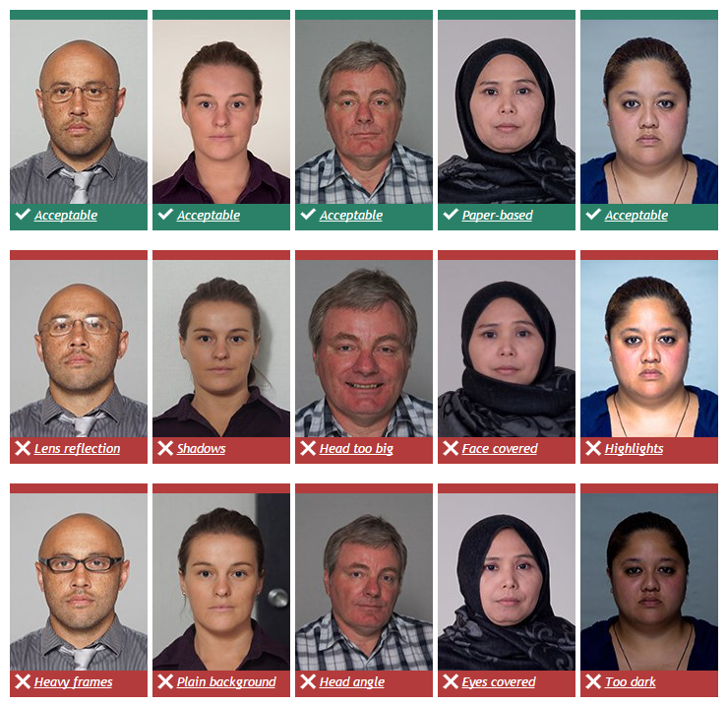
Passport Photos
Photo Basics
Submit a color photo, taken in last 6 months.
Use a clear image of your face. Do not use filters commonly used on social media.
Have someone else take your photo. No selfies.
Take off your eyeglasses for your photo.
Use a plain white or off-white background.

Slide 58
Most Common Forms for a U.S. Passport
1. Application For A U.S. Passport (DS-11)
You should complete this form if you're applying for the first time, you're applying for your child who is under age 16, or you don't meet our requirements to renew your passport.
2. Renewal Application (DS-82)
You should complete this form if you meet our requirements to renew your passport. Keep in mind that children under age 16 cannot renew their passports.
3. Data Corrections, Some Name Changes, and Limited-Validity Passports (DS-5504)
You may be eligible to use this form if you need to change or correct your passport, or you need to replace a passport that was limited to less than 10 years validity (which is the normal validity period for an adult's passport.

Slide 59
Most Common Forms for a U.S. Passport (Continued)
4. Reporting Your Passport Lost or Stolen (DS-64)
You should complete this form if you lost your passport or it has been stolen. To replace a lost or stolen passport, you must apply in person and submit Form DS-11 in addition to Form DS-64.
5. Statement of Special Family Circumstances (DS-5525)
You should complete this form if one parent or guardian cannot locate the other parent or guardian. The parent who is applying should submit this special form in addition to their child's application (DS-11).

Slide 60
Passport/Visa Database
The Visa/Passport application
This tool is designed to track information related to passports, passport applications, and visa applications for persons and their relations traveling on behalf of the Department of Commerce (DOC) and to provide standardized letters and messages to be used when communicating with the U.S. Department of State, embassies, and travelers. The Visa/Passport application will help make sure that a passport is always in a known location and that the needs of a traveler’s itinerary are met before travel begins.

Slide 61
Passport/Visa Database
The Visa/Passport homepage is divided into four main areas:
Traveler – enables users to create new travelers, modify information on existing traveler profiles, and create and modify passport applications, passports, and visa applications
Reports – provides a variety of reports about travelers within the application
Stats – provides various statistical reports on passports and visas within the application
Administration – enables certain users the ability to update templates, messages, and embassies

Slide 62
Visa Processing Procedures
Check the embassy website for the most recent requirements for that country
TMD maintains a list of Embassy requirements
Update accordingly upon learning of new forms and or requirements
Check the passport to determine if it has been signed
If not, please obtain the traveler's signature
Check the passport to review the expiration dates
Some Embassies require that the passport have at least six months validity before issuing the visa endorsement
If the passport is due to expire, instruct the traveler to have the passport renewed

Slide 63
Visa Processing Procedures
Check to make certain that a travel order is attached
Information from the travel order is required to obtain the diplomatic note from the SIA.
If the traveler can not provide a travel order, ask them to complete a hand carry form
Check to make certain that the signature of the passport matches the signature on the application, if applicable

Slide 64

Visa Courier Service
Required Documents
Visa forms
Supplemental documents
Applicable photos
If serviced by the Travel Management Division
Bring those documents Room D-100
We will send your documents to State and Embassy’s on your behalf.

Slide 65

Passport Application Rejections
MOST COMMON REASONS
Failure to use correct form
Photos not properly attached to application, thus lost
Did not provide the correct passport
Dates of travel not reflected on Letter of Authorization (LOA)
No purpose on LOA
No copy of the LOA

Slide 66

Travel Training Meeting
The next Travel Training Meeting is scheduled for July 14, 2022.

Slide 67
Contact Information
Travel Management Division (TMD), Room HCHB-D-100
Travel Management Division Webpage:
https://www.commerce.gov/ofm/offices/office-financial-reporting-policy-internal-controls-and-travel/travel-management

Slide 68
Contact Information
Travel Management Division (TMD), Room HCHB-D-100
Team Members:
Cecelia Kizer, Director, Travel Management Division, CKizer@doc.gov
Vernita Tyler-Brown, Lead, Travel Management Specialist,
VTyler-Brown@doc.gov
April Banks, Program Management Specialist, ABanks@doc.gov
Christopher Brown, Program Management Specialist, CBrown3@doc.gov
Angela Lee, Program Management Specialist, ALee@doc.gov
Rholondra Louis, Program Management Specialist, RLouis@doc.gov
Byron Martin, Travel Management Specialist, BMartin@doc.gov

Slide 69

Questions
Please provide your feedback and thoughts about the current and future program at the:
202-482-1818/OFM-DOCPassportVisaHelpdesk@doc.gov

