Slide 1

Civilian Services Acquisition Workshops
Jonathan Evans (GSA)
CSAW Program Lead &
Senior Facilitator

Slide 2
Civilian Services Acquisition Workshop (SAW):
A facilitated workshop built around a specific acquisition and its multi-functional integrated project team (IPT). The workshop walks the complete team through the performance-based acquisition (PBA) process from beginning to end.
Notes:
The Civilian SAW (CSAW) initiative was proposed by a member of the the Professional Services Interagency Team who had experienced the benefits of the approach. As a result, GSA (in partnership with OFPP) began research into CSAWs.

Slide 3
Workshop Purpose:
Develop the mission, measurable objectives, requirements and performance-based strategies for the [agency requirement] and a roadmap to complete it.

Slide 4
CSAW Objectives:
Understand and Apply the Performance-Based Acquisition (PBA) process and the Steps to PBA
Utilize the tools, resources, techniques, innovations and best practices to successfully execute this requirement
Collaborate as a team through facilitated activities to develop draft documentation for this requirements
Develop a high-level roadmap for successful implementation of this performance-based acquisition
Gain consensus on the path ahead

Slide 5
CSAW Focus
The primary focus of the CSAW is to get all members of the acquisition team or IPT contributing and working together to accomplish the necessary work.
CSAWs focus on getting actual work product started (and possibly completed), giving the team the tools (knowledge, skills and understanding) to continue the process through to completion, and building a team commitment to continuing to work together.

Slide 6
Who Should Attend
For the CSAW to be effective, all members of the acquisition team or IPT need to attend.
The Project Manager, Contracting Officer, and Contracting Officer’s Representatives (CORs) MUST attend the complete workshop.
The SAW should be attended by all key members of the acquisition team.

Slide 7
Who Should Attend
Program / Project Manager (PM)
Contracting Officer (CO) and Specialist (CS)
Contracting Officer’s Representative (COR)
Technical Representatives / SMEs
Customer Representatives (Requirements Owners / Key-Users)
External Support (ex. Assisted Acquisition Support, or external SMEs)
OPTIONAL: Oversight/Management Personnel Representatives (ex. Quality Assurance Specialist, Inspector)
OPTIONAL: IT Support (ex. Enterprise Architect, ISSM, ISSO, System/Product Owner)
OPTIONAL: Budget / Finance Office Representative (when needed – cost type or fixed price incentive contracts)
OPTIONAL: Small business representative(s) (if applicable)
OPTIONAL: Legal Counsel (if there are known legal complexities requiring significant input and participation)

Slide 8
Benefits
What happens in a CSAW? | Resulting in...
Workshop brings the right team of people together based on pre-workshop engagement with executive sponsor(s) and project manager | Reduced lead times and better team dynamics
The highly structured, facilitated workshop is built around the specific needs of the team while walking them through all the steps in the PBA process | Greater participation and accelerated team performance
Teams collaborate to develop the mission, vision, high-level objectives, and team success factors | Clarity of purpose that is shared among all members
Teams identify market research needs, high-level risks, key stakeholders, and a high-level communications strategy | Better overall project management
Teams will identify and refine performance requirements with associated performance standards, AQLs, and quality assurance approach | Better performance outcomes
Teams work together on each step in the PBA process and document the additional actions that will need to be taken after the workshop to complete each step | A high-level roadmap for working together to accomplish the project
Throughout the workshop, the team will gain consensus on their work products and path ahead | Increased stakeholder buy-in the end product

Slide 9
DOT Participant Survey Results*
100% Agree or Strongly Agree that they accomplished Workshop Purpose
100% Agree or Strongly Agree that they met all 5 Workshop Objectives
Appropriate to Project Needs | Logically Organized | Positive Virtual Experience | Effective Facilitated Activities
Agree | Strongly Agree | Agree | Strongly Agree
Useful Materials Provided | Will Result in Better Outcomes | Accelerated Team Performance | Conducted Early Enough to Help
Strongly Agree | Agree | Strongly Agree | Strongly Agree
Effective Facilitation of Process | Facilitators Helped Understand Steps to PBA | Facilitators Encouraged Participation
Strongly Agree | Strongly Agree | Strongly Agree
Facilitators Responsive to Needs & Questions | Facilitators Engaging Energy & Enthusiasm | Helped Reach Consensus
Strongly Agree | Strongly Agree | Strongly Agree
“Great facilitators and guest speakers. I enjoyed the workshop. I would love to have all of our CORs at FTA participate in a workshop like this (possibly even mandatory). It was extremely helpful.”
"The facilitators did a top-notch job keeping everyone engaged under difficult circumstances. While the week was exhausting, I think we all did even better than expected and maintained productivity and camaraderie throughout.”
“What I liked best was the flow of instruction and how one aspect builds upon the other. I also appreciate having facilitators so the group maintains focus and avoids going off in tangents.”
“Highly effective. Appreciate the facilitation, tools, assistance and team development. Definitely appreciate project charter facilitation and development assistance.”
* 62% (8/13) of participants responded

Slide 10
Other Benefits
Issued 40 CLPs to each participant
Promoted CM principles, acquisition innovations, and market research tools
Meets the Frictionless Acquisition Cross Agency Priority Goal
As facilitated requirements development workshop, CSAWs are tool to achieve PALT
Reduced agency administrative costs (travel) due to effective virtual delivery approach
GSA is currently offering CSAWs at NO COST

Slide 11








STEPS TO PERFORMANCE BASED ACQUISITION
STEP 1
Form the Team
STEP 2
Identify Objectives
STEP 3
Market Research
STEP 4
Develop Work Statement
STEP 5
Define Measures
STEP 6
Source Selection
STEP 7
Manage Performance
STEP 8
Complete Closeout
PURPOSE: Establish the team and conduct high-level project planning. POTENTIAL OUTPUTS: - Project Vision, Mission & Team Success Factors - Stakeholder ID & Analysis - High-Level Communications Plan - High-Level Risk ID - Project Charter | PURPOSE: Identify why we’re doing this in the first place and what are the high-level objectives (HLO). POTENTIAL OUTPUTS: - Review/analyze current approach - Tie project into Agency Mission / Strategy - Establish High-Level Objective | PURPOSE: A team approach to market research using available tools and innovative resources. POTENTIAL OUTPUTS: - ID Market Research Topics / Questions - Team market research assignments - Draft MR document - Draft IPT Master Schedule | PURPOSE: Well-written requirements statements and identifying the appropriate work statement type. POTENTIAL OUTPUTS: - Draft Performance Requirements Statements - Draft Work Statement Template Selection - ID Solicitation Requirements | PURPOSE: What constitutes successful performance and how does the team measure this? POTENTIAL OUTPUTS: - Develop performance standards and possible incentives - Review acquisition strategy alternatives | PURPOSE: Review options for evaluation criteria and think through the source selection process. POTENTIAL OUTPUTS: - Explore innovative source selection approaches - ID Tech Eval criteria | PURPOSE: Managing the contract to ensure performance objectives are met. POTENTIAL OUTPUTS: - Draft Risk Management Plan - QASP vs. QAP - Performance tracking approach - Roles & Responsibilities - Change & Transition Management | PURPOSE: Considerations for closing out the contract and concluding the project. POTENTIAL OUTPUTS: - Lessons Learned - Celebrate Success - Document in CPARs
Notes:
https://pba.app.cloud.gov/app/#/pba

Slide 12
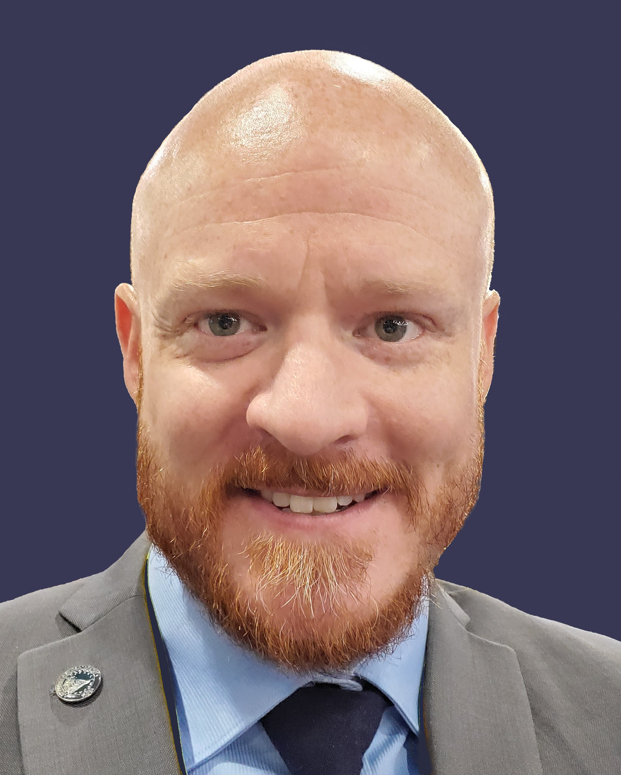

Contact
Jonathan Evans
CSAW Program Manager
Office of Professional Services & Human Capital Categories
GSA Federal Acquisition Service
Email: jonathan.evans@gsa.gov

