Slide 1
CSC Portal - BAS Page
Issues viewing Content on CSC Portal BAS Page
Hello BAS Community!
We are excited to provide you with new content on the CSC Portal BAS Page throughout Common Solution.
This proprietary content (available on DOC network) includes:
Real Property Deployment Self-Service Documentation
Sprint Outcomes
Additional BAS Documentation to help prepare you for upcoming Finance, Asset Management, Acquisitions, and Reporting/BI deployments.
If you experience issues viewing specific content on the CSC Portal BAS Page, please clear your cache using the instructions in this presentation:
Slide 2: Edge
Slide 3: Chrome
Slide 4: Firefox
If you are still experiencing view issues after clearing your cache, please contact the BAS OCM Team at: ablumenthal@doc.gov, mscarlato@doc.gov, tcarpenter@doc.gov

Slide 2
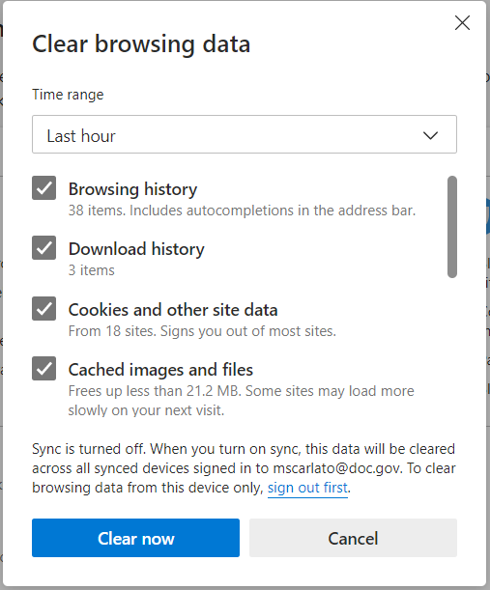
Microsoft Edge
Clear Cache Instructions
Click CTRL+SHIFT+DEL on while your Edge browser is open.
Refer to the figure at right, and ensure the following options are selected:
Time Range: Last Hour
Download History: Yes
Cookies and Other Site Data: Yes
Note, deleting cookies may log you out of websites that have remembered your login information.
Cached Images and Files: Yes
Click Clear Now.
Access the CSC Portal BAS Page. You should now be able to view all uploaded documentation.
If you still cannot view specific CSC Portal BAS Page content, please repeat steps 2, 3, and 4, but select Time Range: All time in step 2.
Additional Resources for Microsoft Edge
Clear your cache in Microsoft Edge (Windows) (clear-my-cache.com)
Delete cookies in Microsoft Edge

Slide 3
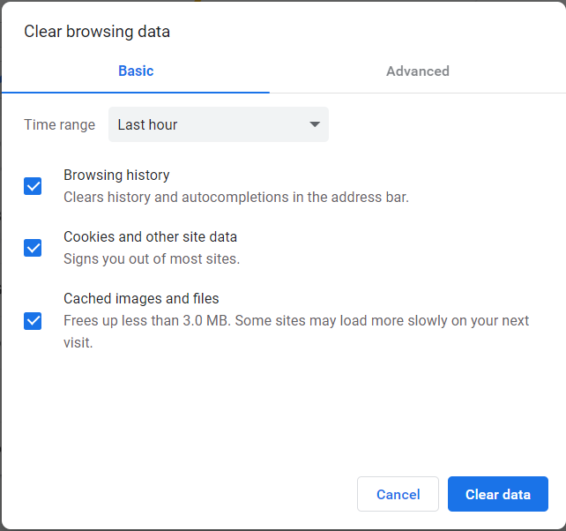
Google Chrome
Clear Cache Instructions
Click CTRL+SHIFT+DEL on while your Chrome browser is open.
Refer to the figure at right, and ensure the following options are selected:
Time Range: Last Hour
Browsing History: Yes
Cookies and Other Site Data: Yes
Cached Images and Files: Yes
Click Clear Data.
Access the CSC Portal BAS Page. You should now be able to view all uploaded documentation.
If you still cannot view specific CSC Portal BAS Page content, please repeat steps 2, 3, and 4, but select Time Range: All time in step 2.
Additional Resources for Google Chrome
Clear cache & cookies - Computer - Google Account Help

Slide 4
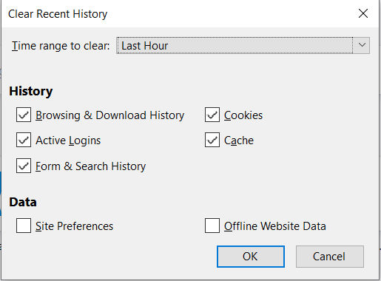
Mozilla Firefox
Clear Cache Instructions
Click CTRL+SHIFT+DEL on while your Firefox browser is open.
Refer to the figure at right, and ensure the following options are selected:
Time Range: Last Hour
Browsing & Download History: Yes
Active Logins: Yes
Form & Search History: Yes
Cookies: Yes
Cache: Yes
Click Clear Data.
Access the CSC Portal BAS Page. You should now be able to view all uploaded documentation.
If you still cannot view specific CSC Portal BAS Page content, please repeat steps 2, 3, and 4, but select Time Range: Everything in step 2.
Additional Resources for Mozilla Firefox
How to clear the Firefox cache | Firefox Help (mozilla.org) – for official help
How to Clear Cache on Firefox in 2 Different Ways (businessinsider.com) – to automate cache clearing (if you choose to do so)

