Slide 1
U.S. Government Rental Car Program Department of Commerce January – December 2020
February 9, 2021

Slide 2
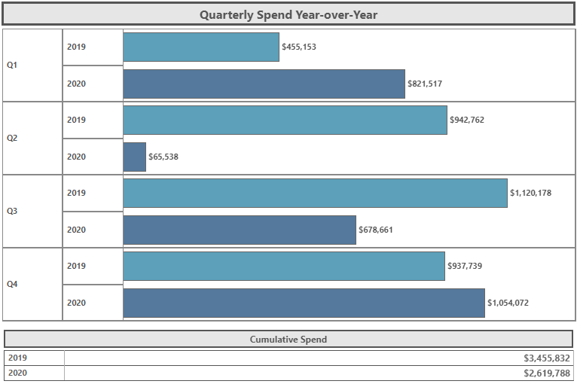
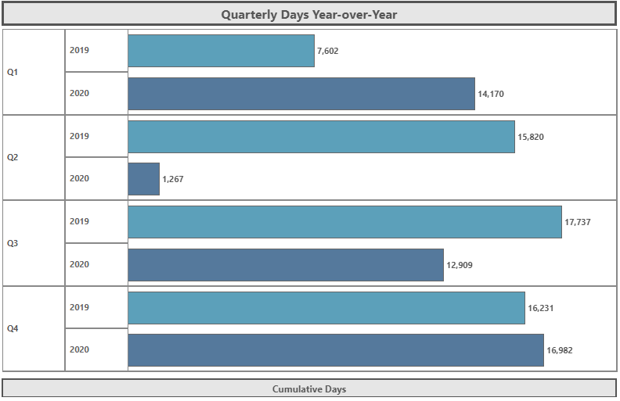
Quarterly Spend and Days Year over Year
2019 | 57,390
2020 | 45,328

Slide 3
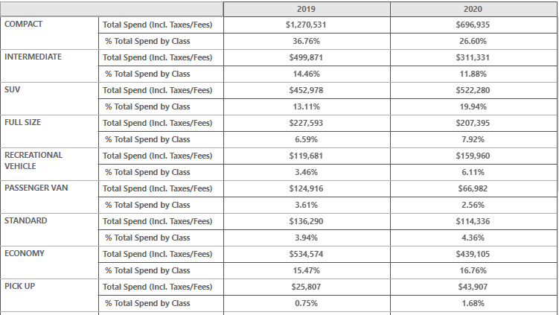
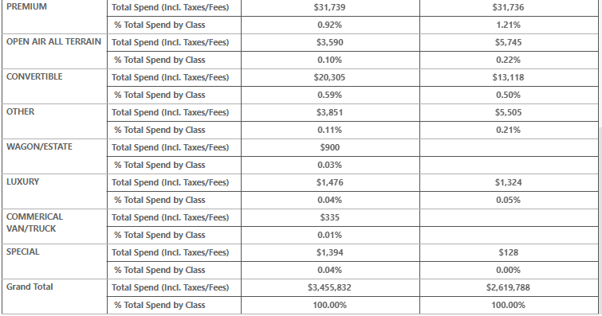
Total Spend by Car Class

Slide 4
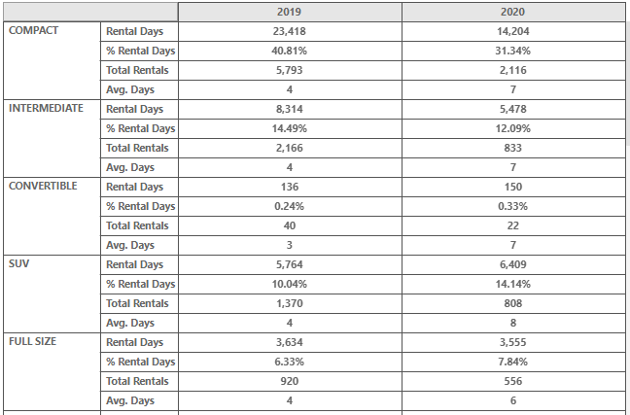
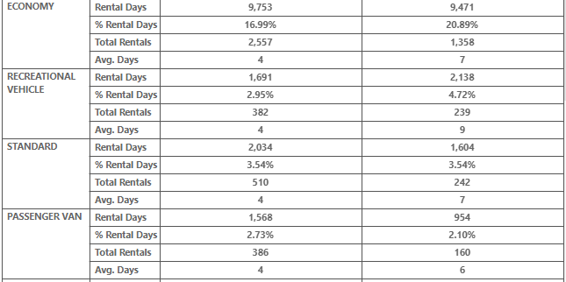
Total Days by Car Class

Slide 5
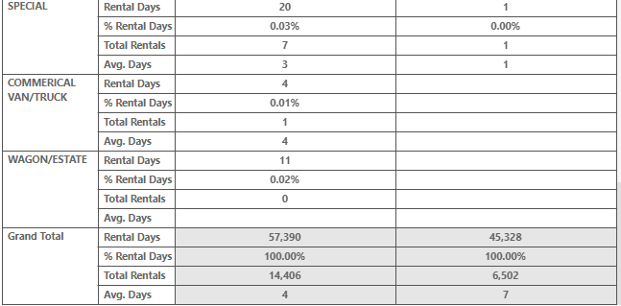
Total Days by Car Class…continued
Note: Car Class Description
Open Air All Terrain Vehicle – Jeep Wrangler, Honda Ridgeline, Honda Rugged, etc.
Other – Any vehicle not defined by the Association of Car Rental Industry System Standard (ACRISS) or if car rental company does not utilize all industry standard car types, they categorize as other. Special – Motor Home, 2 wheel vehicle, Roadster, Crossover

Slide 6
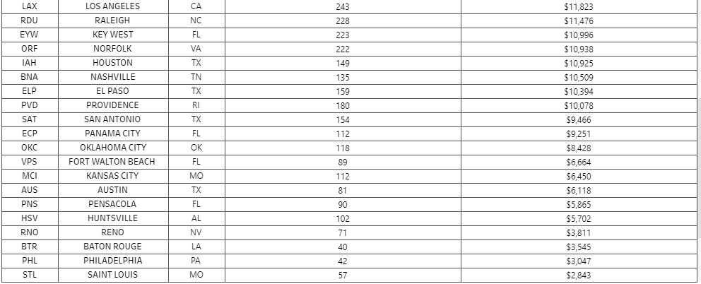
2020 Top CONUS Airports by Spend and Days

Slide 7
2020 Top OCONUS Airports by Spend and Days

Slide 8
Need to Know
Return the vehicle with the same level of fuel in tank as when the vehicle was picked up.
Additional drivers who are properly licensed government employees 18 years or older are covered without additional charge and need not be listed on the rental car documentation
GARS is an authorized $5 per day fee that is intended to address those costs incurred by the rental car company that are peculiar to doing business with the Government. Be sure the Government Administrative Rate Supplement (GARS) of $5 per day is on the rental contract to ensure all benefits are included in the rate
Frequent renter programs are offered at not cost to the Federal government employees and participation is voluntary. Ensures travelers receive the benefits of the Program. Sign up here: https://www.defensetravel.dod.mil/site/rentalCarFRP.cfm
Rental Car Assistance – Renter should first attempt to resolve the issue directly with the rental car company. If additional assistance is needed, go to the Rental Vehicle Assistance Tool located on DTMO website at: https://www.defensetravel.dod.mil/Rental
You may register accidents or damage as well as compliments or complaints using this tool.
DTMO personnel will assist in resolving your case.
Send Rental Car Questions to: dodhra.mc-alex.dtmo.mbx.rental-car-program@mail.mil

