Slide 1
Table Talk November 2020
November 2020

Slide 2
Core Applications - Global Design Outcomes and Next Steps
Enterprise Data Warehouse - Global Design Outcomes and Next Steps
Risk Management – Your Role
Pulse Check
Notes:
Welcome to our November Table Talk. Today, we will be discussing three topics of current interest. The first two topics will cover the outcomes of Global Design from both the Core Apps and EDW perspective and provide insights into how these outcomes feed activities moving forward. Our speakers will also provide a timeline to show you what you can expect in the coming months.
Our third topic, Risk Management, is also timely for where we are in the program. It is vital to the BAS program that we identify risks early, and you play a key role in our Risk Management program. Our speaker will discuss your role in identifying risks so that we can address these before they become issues - thereby avoiding costly and negative impact to the program.
We strongly recommend that you ask us any questions you have throughout the Table Talk. These can be typed into the chat line, or you can enter them through our Pulse Check at the end of the session (especially for those who dialed in). We will answer all of your questions after the session and provide each of you with a copy of all the questions and answers from both sessions of this Table Talk.
As you have probably heard, we have posted all of the slides from this Table Talk on our website as an alternate way to follow along or for later reference. If, in reviewing the slides after the session, you have additional questions, you can ask these through our new “ask a question” feature in out BAS website FAQ section.
As with earlier sessions, we will end the session with our Menti pulse check – so keep your phones handy and we’ll get started.

Slide 3
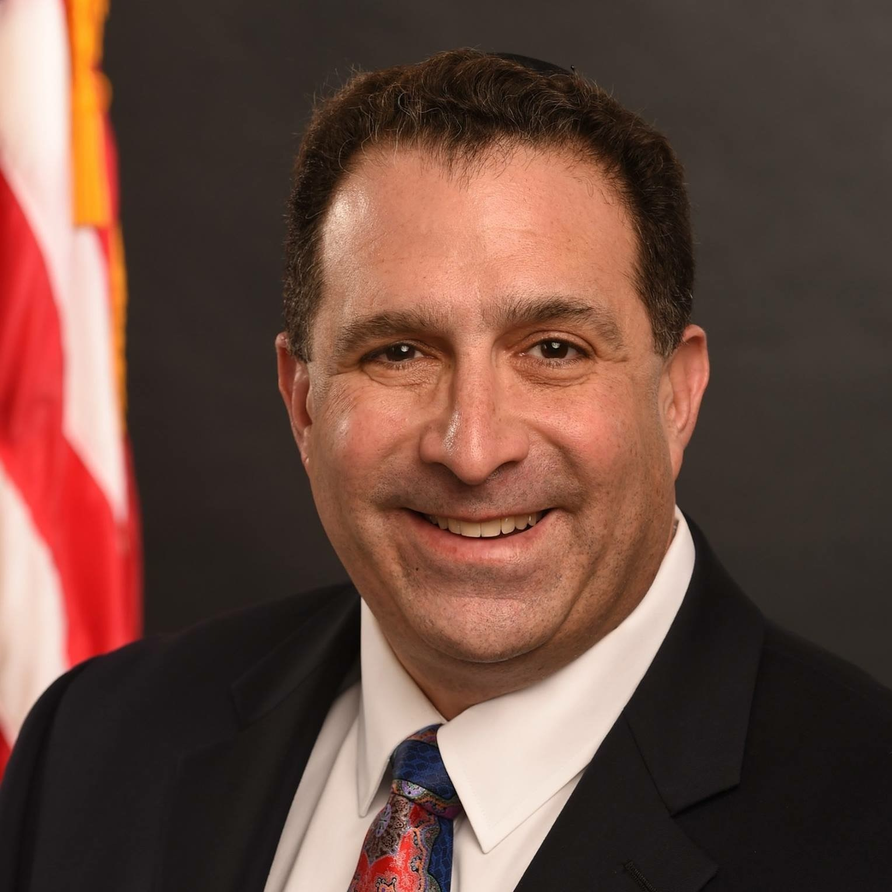


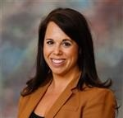

BAS PROGRAM TABLE TALK
Presenters
Andy Blumenthal
BAS Deputy PM
Angela Hang
AFS EDW Lead
Dwight Whitted
AFS EDW Team Member
Mary Beth Torpey
AFS Functional Core Financials Lead​
Rakesh Raman
BAS Risk Lead

Slide 4
Core Applications - Global Design Outcomes and Next Steps

Slide 5




BAS Table Talk – Core applications
Global design outcomes to drive common solution
96
86
BACKLOG
KEY DESIGN DECISIONS
  From workshops, compiled a list of items to review during Common Solution
  CS Impact: Review any open backlog questions during Sprint sessions and drive deep dive discussions
  Confirmed 86 KDDs by workstream
  Identified differences among bureaus as part of workshops
  CS Impact: KDDs will drive CS business process recommendations which will be reviewed during Sprints.
1642
101
REQUIREMENTS
EXIT CRITERIA
  Identified additional CS topics
  Established initial list of data calls to support configuration validations
  Identified 101 non-functional questions and pain points to support future discussions
  CS Impact: Leverage details from Exit Criteria to shape Deep Dives
  Used 1642 requirements as baseline for GD
  Reviewed post-workshop to prepare for CS
  Identified a small subset (89) as requiring additional confirmation as part of CS
  CS Impact: At the end of each Sprint, we will review impacted requirements and submit through requirements review process.
Notes:
Discuss here the overall flow of the requirements > KDDs > exit criteria vs. Backlog – how are these used as starting points for CS
What are the key things that will be leveraged / discussed in CS

Slide 6
BAS Table Talk – Core applications
Common solution wins to date
Wonderful partnership and collaboration across different teams
Confirmed BAS Account Code Structure
DOC Ledger structure review – the foundation of the core
financials
Real Property for April deployment kickstart – 9 sessions in October alone!
Deep dive into Advanced Acquisition Planning – tackling
complex policy decisions from Month 1
20+ Deep Dive Sessions across Core Applications

Slide 7

BAS Table Talk – Core APPLICATIONS
Observations, questions, misperceptions, and pain points
Bureau experts provide great insights into the DOC way of doing business.
December will bring us back together to show the Configuration Validation Sessions – we will walk through business processes and transactions together. This will help us see the previous concepts discussed in Sprint 1 in the system.
Your excitement is wonderful – we are tracking your questions and asks to support future phases e.g. training. We share those with the other work streams like the Organizational Change Management team.

Slide 8
BAS Table Talk – Core applications
CS Sprints per application
Sprint 1 FY2021 Q1
Planned Outcomes
PRISM
Advanced Acquisition, Requisitions
Confirmed template requirements to support Advanced Acquisition Planning
Standardized Requisition Numbering for all bureaus
EBS
AP: Invoices, Approval Hierarchies,
AR: Reimbursables, Billing
GL: Ledger Overview, ACS, CVR
PA: Cost Allocation, BAS Data Standardization, Object Classes, Labor Costs
Approval Hierarchies for transactions
Reimbursable and Billing Process (Pre G-Invoicing)
Confirmed One Ledger
Defined Account Code Structure
Standardized Object Class approach
Cost Allocation Methodology
SF
Real Property: Acquisition, Utilization, Finance Treatment, Disposals, Reporting / Interfaces
FRPM to SF Real Property busines process mapping
Required reports to support RP
April 2021 Go-Live Expectations
INT
SAM
PRISM – EBS
Sunflower – EBS
SAM Standardization
PRISM to EBS data validations and financial impact
To-be process for Sunflower Financial Treatment
8
Notes:
Note that this view aligns with the CS calendar for the topics per session per sprint; The last quarter of CS is heads down for the overall project team; we have a Sprint 4 in case any other items are identified during this phase that need to be addressed. Note that Sprint 4 might be a catch all for G-Invoicing.

Slide 9
BAS Table Talk – Core APPLICATIONS
Working together to ACHIEVE Common solution success
October
November
December
Begin discussions related to policy and procedures impact
Participate in the deep dive discussions to align configurations and business process to DOC policy requirements
Confirm CS configurations with dedicated workshops to review policy and DOC requirements
Perform and review initial configuration
Discuss, review, and validate initial configuration settings and values
Respond to data calls for Configuration Validation Sessions
Identify process improvements and potential workarounds
Prepare business process scenarios for system validation session / purposes to mimic real business cases
Identify system configuration integration points
Discuss, review, and validate transaction flow with SMEs
Discuss and provide direction for configuration options
Assess system roles and responsibilities and access
Document To-Be Business Process
Work with business community members to resolve Sprint Sessions parking lot items
Review recommended business processes during Configuration Validation Sessions
Conduct Configuration Validation Sessions based on CS configurations and confirmed business process flows
Perform walkthrough of system transaction flow
Provide configuration options and alternatives to meet requirements
Discuss and agree on configuration options
Update Requirements Traceability Matrix
Deep dive
Data calls
validation

Slide 10
BAS Table Talk – Core APPLICATIONS
Common solution deliverable Progress
MONTH 1 – COMPLETE
Validate Common Solution
Identify Above and Beyond Requirements
MONTH 2 – IN PROGRESS
Update RTM
Develop Test Strategy (Test Scripts, Test Plan)
MONTH 3 – PLANNED
Present Targeted Validations
Update Implementation Plan
FUTURE SPRINTS
Include:
Solution Design
Conversion Strategy
Interface Strategy
Training Plan
PHASED DEPLOYMENTS
Notes:
The key take away here is that the CS is to validate the CS for the entire department
These deliverables are from the PWS / IMS - based on feedback we received during GD, may users asked about these key topics / work products and we provided feedback of what phase they would fall under to allow them visibility into the larger picture

Slide 11
Enterprise Data Warehouse - Global Design Outcomes and Next Steps

Slide 12


BAS Table talk - EDW
Global Design Outcomes
 | Objective | Provide the Department, Bureaus, Line/Lab/Program offices the tools and capabilities needed to manage their business, anchored on operating consistently as an enterprise. Single standardized instance of enterprise data warehouse - one-stop-shop for data needs – for use across the Department, Bureaus, Line/Lab/Program Offices as common ground for data and insights Robust reporting tool that empowers users to build reports/dashboards the way they need it – e.g. copy & customize, drill to detail, export, creation of team workspaces.
 | End-User Focus | BAS core applications offer a robust suite of operational reports – learn about these throughout Common Solution. Additional reporting needs – operational, cross-business function, managerial – can be developed with EDW ad-hoc reporting capability. BAS EDW will develop the data foundation (data processes, integrated reporting tables, pre-joined datasets in the BI tool) to support ad-hoc reporting. To drive towards operating as an enterprise, create “community focus” reporting areas organized by business function (e.g. Finance, Budget, HR). BAS will work with each group to identify Power Users and provide them training in how to develop and publish reports for their community. The BAS program will also be developing priority advanced analytics features.

Slide 13
BAS Table talk - EDW
BAS Reporting Universe
EDW
Core Applications
Strategic
Analysis
Dashboards & KPIs
Operational Reporting Analysis
Transactional Data Creation
MANAGERIAL REPORTING Business scenario simulations – “what if” analysis Ad-hoc analysis & queries Strategic budget and planning Executive Scorecards/Dashboards & Insights Support decision making based on fixed data analysis
OPERATIONAL REPORTING Detail to support management reporting Operational analysis Financial consolidation and analysis Federal Reporting
Real time reporting to support daily operations Single query
BAS Core Applications offer robust suite of reports to handle day-to-day reporting needs. Learn about these operational reports throughout Common Solution sessions.
BAS EDW will provide self-service reporting capability to support development of any other operational reporting needs. Use cases are geared towards cross-function managerial reporting and analytics.
Single entry point and single sign-on for all BAS apps through the BAS Portal.
CORE APPLICATIONS |  | EDW
Standard Reports Operational Reports Single function dataset Federal Reporting |  | Self-Service - Report needs not addressed by Core Applications Standard Reports Managerial Reports Cross function datasets Ad-hoc Data Calls
Notes:
Part of the change journey is to work with users to deconstruct current system reporting architecture and recategorize into BAS applications.

Slide 14
BAS table Talk - EDW
Reporting Change Journey
The following shows the journey from learning about BAS operational reports during Common Solution,
to working with you on how to address additional reporting needs during Implementation Preparation,
to working with your Community Power Users to develop evolving reporting needs post-go-live.
 | FY21 | FY22 | FY23 Q1 | FY23 Q2 – Q4
User Change Journey
 |  |  | Power User Report Development
EDW Development
Common Solution
Select & configure core application operational reports
Map needs to BAS standard reports
Implementation Preparation
For any gaps, identify solution, discuss with BAS CCB, and work with users on how this will be addressed
Go-Live
Users work with live operational reports. Develop additional/new reporting needs in EDW Community BI Mart.
Develop Data Foundation
Community Powered BI
& Ad-hoc Capability Enabled
(BAS to support Power User report development)
Develop
Advanced Analytics Features
(by BAS EDW application team)
Develop BI Foundation
Continued enhancement of Data and BI Foundation based on analytics, managerial, and ad-hoc reporting needs

Slide 15




BAS Table talk - EDW
Global Design Outcomes
 | Data Sources | Prioritizing data feeds that meet cross-business function reporting objectives. Additional feeds can be added post-BAS implementation, based on need and value. Early deployment of first half of data sets in FY22 Q1 to work through network connectivity and ATO.
 | Retiring Current Systems | Current financial/acquisitions/property systems data will be copied into the EDW Data Lake. Reviewing current reporting applications for functionality that support cross-function enterprise missions, to adopt into BAS EDW (e.g. MARS).
 | Architecture | Designed for continued development of advanced BI and analytics capabilities in the future. Vendor hosted and managed. Fit-for-purpose tech stack – add/remove services as needed. Scale up/down on demand.
 | Security | XDR for continuous security monitoring and vulnerability detection. Annual ATO review of security posture.

Slide 16
BAS Table Talk - EDW
What’s In Scope & Schedule
 |  | FY22 (Go-live 10/1/21) |  |  | FY23 (Go-live 10/1/22) |  | FY24 (Go-live 10/1/23) |  | FY25 (Go-live 10/1/24)
DATA | Inbound Data Ingest &Transformation into Integrated Data Model – data starting from point of Go-live; no historical data load | Inbound Data Ingest &Transformation into Integrated Data Model:
DATA |  | Travel: E2 MIS mLINQ | HR/Payroll: NFC WebTA | Grants: Grants Online OPCS | BAS Financial BAS Acquisition BAS Property |  | Grants: GMIS USPTO (Data files USPTO provides the Department today, automate load into EDW)
 | Full History Copy of Current System data into the Data Lake – data copy starts 10/1 and completed by end of Q1 | Migrate full history of Current System data into the Data Lake:
 |  | FRPM (All Bureaus) |  |  | NOAA CBS (NOAA, BIS, EDA) NOAA C.Suite (NOAA) |  | NIST CBS (NIST, BEA, ITA, MBDA, NTIA, NTIS, OS, OIG) NIST C.Suite (NIST) | OS ES C.Suite (BIS, EDA, BEA, ITA, MBDA, NTIA, FirstNet, NTIS, OS, OIG) | Census CBS (Census) Census C.Suite (Census) Legacy Sunflower (All Bureaus)
 | Outbound BAS Data Service (e.g. EBS integration or EDW extract of financial data) to support out of scope functionality (e.g. custom data entry projection tool dependent on financial data) | BAS Data Service (e.g. EBS integration or EDW extract of financial data) to support out of scope functionality (e.g. custom data entry projection tool dependent on financial data)
 |  |  |  |  | MARS (NOAA) |  | (NIST TBD) |  | (Census TBD)
BI REPORTING | Data universes for Community Powered BI Marts (Ad-hoc Reporting) | Data universes for Community Powered BI Marts (Ad-hoc Reporting):
 |  |  |  |  | Program Manager Finance Budget Acquisitions | Grants HR Property Travel
 | Advanced Analytics Features – With Agile, priorities and plan will be reassessed at the start of every release and adjust as needed (e.g. reporting change journey resulting in other enterprise reporting needs) | Advanced Analytics Features
 |  |  |  |  | Acquisitions / Agreements 360 Dashboard |  | Budget & Spend Planning Position Planning
ARCHITECTURE & SECURITY
 |  | AIP Infrastructure: AWS Security: Controls & ATO |  |  | AIP Infrastructure: Tableau Security: Controls & ATO |  | Security: Controls & ATO |  | Security: Controls & ATO
Notes:
Talking Points:
Priority needs is one-stop-shop for data – so that is what we’ll be focusing on in FY21 and FY22.
Before we can turn on data pipelines in production, the application and connectivity to data sources needs to go through evaluation of security controls and receive ATO (Authority to Operate). So Go-live will occur at the same time as BAS core applications on 10/1/YY.
EDW follows an Agile development methodology, which means we break up the product features into chunks and tackle each piece at a time, demoing after each “sprint” of requirements/design/development.
As opposed to traditional Waterfall development where a significant duration is spent before development starts to define detailed requirements (RTM) and design the full solution – misses the opportunity to get early and frequent feedback, and risks missing the mark.
In the sprint (quarter) prior to when a feature is scheduled to be developed, we will reach out to the relevant stakeholders to gather more information and finalize prior to starting development.

Slide 17
BAS Table Talk - EDW
What’s Not In Scope
FEATURE | COMMENT
Inbound Data Ingest & Transformation from data sources not identified for EDW during program planning. | Some of these systems will interface with BAS Core Applications to support operational transactions and reporting. After users get familiarized with operational reporting available in BAS Core Applications, determine what other data sources are needed. Can manually upload to BI tool until automated feed can be built (post BAS implementation). Identified by Acquisitions community as used for reporting: FAAPS, FPDS-NG, OMB MAX, ESRS, CPARS, PPIRS, SAM, FAITAS, AIM, GSA + GSA-sponsored acquisition systems Identified by Grants community as used for reporting: SAM, USA Spending, ASAP Identified in MARS for HR reporting: RADS Identified by Property community as used for reporting: BUILDER, (NIST) MAXIMO, NIST Facilities MIS Identified by Travel community as used or reporting: TMD
Conversion of current system data outside of standard core applications conversion (which includes open transactions only) | Core Applications will convert all open transactions from legacy systems into Core Application tables. EDW ETL will extract Core Application data, including legacy converted data, and transform into EDW integrated reporting data model. EDW will copy all legacy system data and store in legacy format into the EDW Data Lake for access if needed. (The tool used to copy data does not transform legacy data into the new data model).
Historical copy of systems not being replaced by BAS | Grants, HR/Payroll, and Travel data sources
Historical copy of documents from current systems | Only current system data will be copied
Outbound Data Service to other systems for purposes redundant with BAS enterprise objectives | e.g. financial reporting
Data entry to create / update operational or reference data | e.g. updating Table of Organization in EDW
100% replication of current reporting systems | Functionality specific to a program may persist
17
Notes:
Acronym List
Acquisition
FAAPS: Forecasting Advanced Acquisition Planning System
FPDS-NG: Federal Procurement Data System - Next Generation
ESRS: Electronic Subcontracting Reporting System (GSA system)
CPARS: Contractor Performance Assessment Reporting System
PPIRS: Past Performance Information Retrieval System
SAM: System for Award Management
FAITAS: Federal Acquisition Institute Application System
AIM?
Grants
ASAP: Automated Standard Application for Payments
SAM: System for Award Management
HR
RADS: Recruiting Analysis Data System
PPS: Performance Payout System, @EAS/DOTESC
SES: Senior Executive Support
Property
Travel
TMD: Travel Management DB

Slide 18
Risk Management –
Your Role
18

Slide 19

BAS Risk Management
Key Definitions
Risk – Potential for loss, harm, or missed opportunity due to uncertainty
Issue – A risk that has been realized
Risk Statement – Concise statement using IF… THEN…
Risk/Issue Owner – Individual responsible for tracking and monitoring risk/issue
Trigger Date – Date when risk becomes an issue or date issue must be resolved to minimize further negative impacts to the project
Response Plans – Actions needed to mitigate the risk or resolve an issue
Risk Management Plan – Document with the processes, tools etc. needed to implement risk management at DOC
Risk/Issue Registers – Repository to gather and track risks and issues

Slide 20
BAS Risk management
Risk submission and update process
Risk/Issue Submission Process
Risk/Issue Submitter /Owner completes the online form.
Risk Lead receives the information, reviews the risk/issue for completeness and relevancy.
Risk Lead contacts the owner and the submitter for additional details/clarification.
Risk Lead enters the risk/issue in the register.
Risk/Issue Update Process
Risk Owner contacts Risk Lead if there are material changes to risks/issue.
Risk Lead contacts Risk Owners monthly for updates.
Risk Lead updates the Risk Register.
  Critical risks
  Risks with upcoming trigger dates

Slide 21
BAS Risk Management
Risk categories
Risks are currently spread across all categories.
Risk Category | # Risks (10/23/2020)
Budget | 3
Enterprise Data Warehouse | 1
Functional – Core Apps | 18
Integration | 2
Migration (includes data conversion, testing, Go-Live) | 14
Organization Change Management | 9
Program Management (includes resources, schedule, scope, reporting) | 23
Security | 5
Technical (includes hosting, infrastructure, networking etc.) | 13

Slide 22
Bas risk management
Risk closure process
Risk/Issue Closure Process
Risk Owner submits information via email
to the Risk Lead for closing a risk.
Risk Lead reviews the details.
Risk Lead contacts the owner for additional details/clarification.
Risk Lead enters the relevant information in the register and indicates the risk as closed.

Slide 23


Bas Risk management
Roles and responsibilities
Risk Owners | Risk Lead
Accountable for the risk and its impacts, including implementation and performance of the risk response plan | Facilitates the risk management process, assists with identifying risks, logs the risks/issues in the register, and facilitates the risk meetings
Escalates risk if existing mitigation is not effective or if decisions or additional resources etc. are needed to manage the risk | Provides guidance and technical assistance to BAS risk owners so they have sufficient knowledge and resources to manage their risks
Provides updates to the risk and participates in regularly scheduled risk meetings | Connects stakeholders and builds support for implementing an evidence-based approach to BAS Risk Management

Slide 24

Bas risk management
Some commonly asked questions
Is the Risk Submitter the same as the Risk Owner?
If I identify a Training Risk, what category would I put it in?
What’s the best way for me to find out if a risk I want to submit has already been submitted?
If a risk turns into an issue, does it automatically move to the most serious risk in the Risk Register (red in the heat map)?
Why is it important for me to submit a risk?

Slide 25
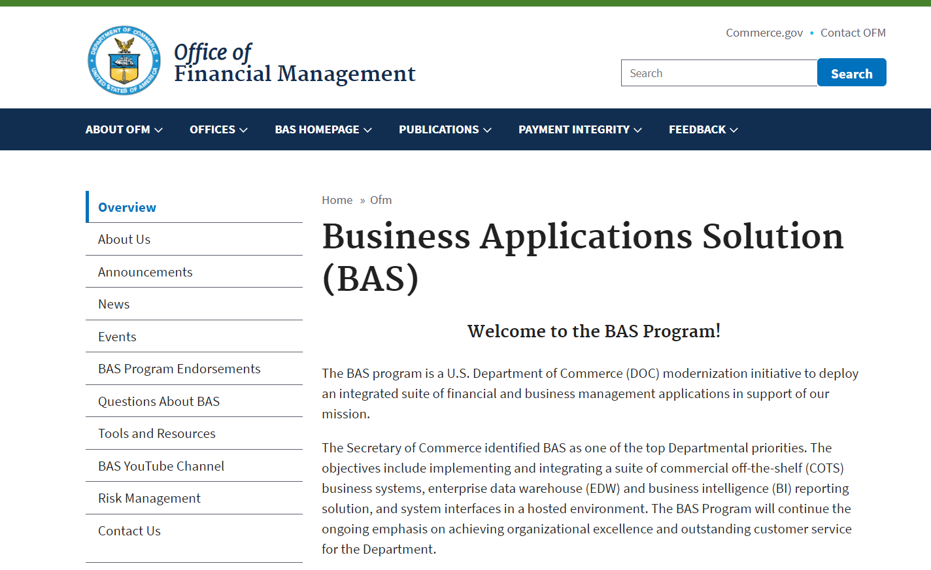
Bas risk management
Risk management on the bas website
https://www.commerce.gov/ofm/bas-homepage/business-applications-solution-bas
Because this is an open website, you may be asked to sign in for security purposes.

Slide 26

BAS PROGRAM TABLE TALK
NEXT event
Town Hall -
  Program Status Update
  January 25, 2021 (NOAA and NIST)
  January 26, 2021 (Census and HCHB)

Slide 27
BAS PROGRAM – Table talk
Have a question about the BAS Program?
Several ways to get your question answered:
Use the chat window for this event.
Type your question in the Menti.com survey – last question.
*NEW* Use the “Submit a BAS Question” feature in the “Questions about BAS” section of the website.
Q&A

Slide 28
Bas program update
We need your input
We’d like your input using Menti.com (authorized by DOC for use at these events).
Sign in using your computer, phone, or other electronic device.
www.menti.com
Enter the passcode when prompted.
82 87 51 7 (NOAA and NIST)
25 58 76 9 (Census and HCHB)
Answer the question that appears – all responses are anonymous.

