Slide 1
Table Talk
August 24, 2020

Slide 2
1
01
Software as a Service (SaaS)
2
02
Hosting Platform
3
03
Security
4
04
Getting Involved
2

Slide 3
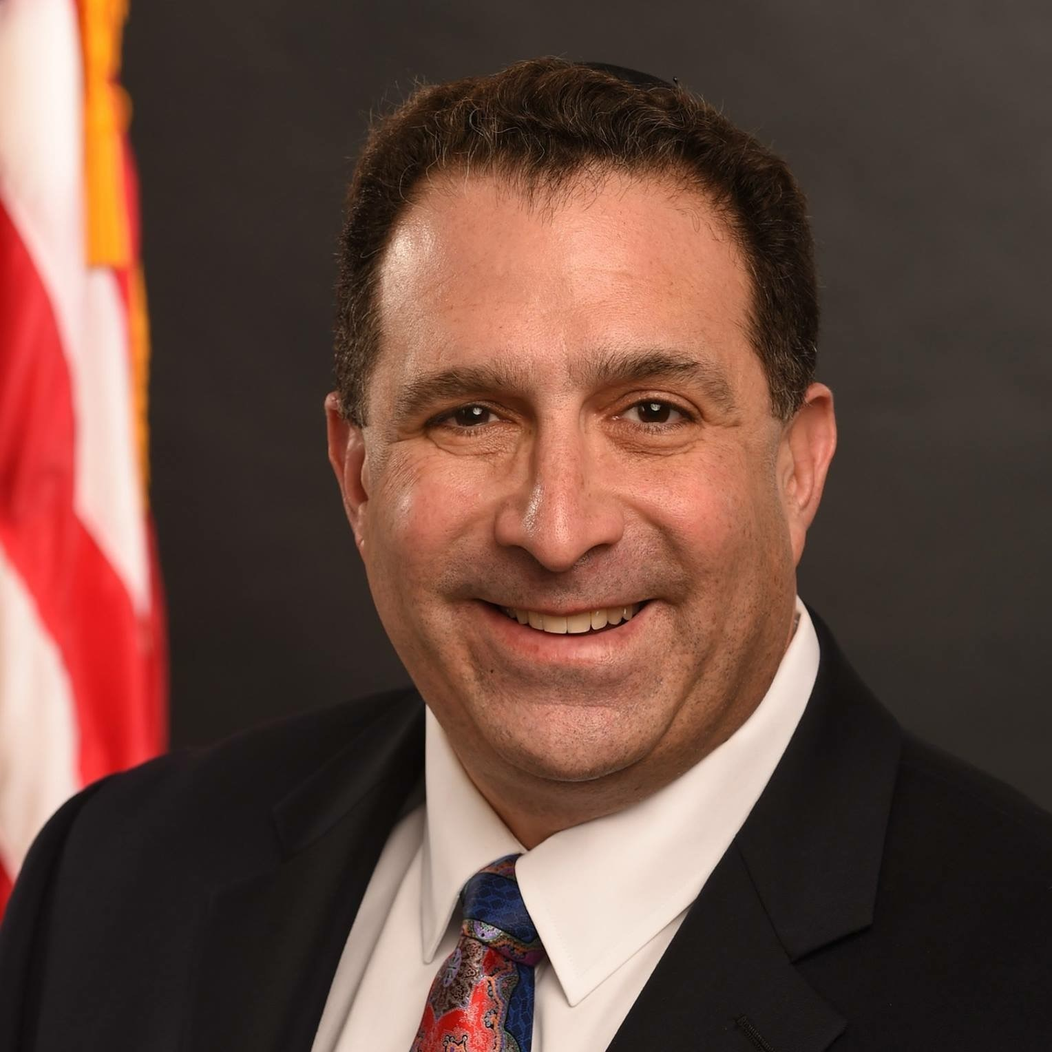

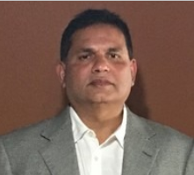


BAS PROGRAM TABLE TALK
Presenters
Andy Blumenthal
BAS Deputy PM
Rick Murray
AFS BAS Project Manager
Sai Pakkam
AFS BAS Technical Architecture Lead
Michelle Woolfolk
AFS BAS Security Program Lead
Jon Ford
AFS BAS Security Lead
3

Slide 4
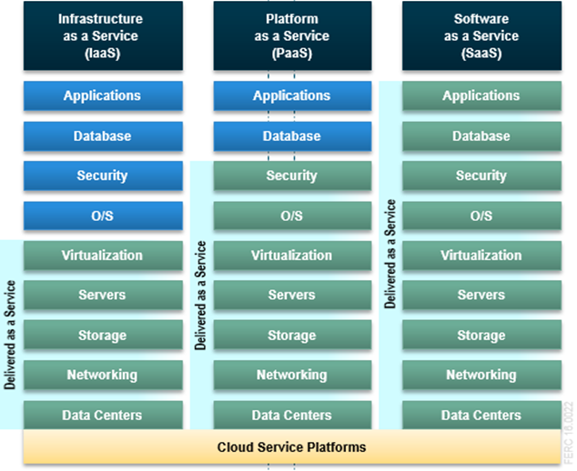
BAS PROGRAM TABLE TALK
Differences between Iaas, Paas, and Saas
Cloud Computing Service Models
  Infrastructure as a Service (IaaS) - Most basic cloud service model. Providers offer infrastructure services - compute services (physical or virtual), networks, storage and firewall.
  Platform as a Service (PaaS) - Providers offer a computing platform, which includes the IaaS model along with the operating systems, web servers, and security services.
  SaaS – Most comprehensive cloud service model. Providers offer all the aspects included in the PaaS platform, in addition to installation and management of application software.
SaaS
Platform
Security
Delivered as a Service
Managed by the Purchaser
4
Notes:
Rick

Slide 5
BAS PROGRAM TABLE TALK
Commerce Benefits of SaaS
Flexibility
Reliability
Ability to rapidly scale infrastructure to meet changing business needs
Access to latest technology to allow for continuous innovation
Always on latest version of software
Managed Service with operation teams monitoring system for system performance and availability
SaaS
Benefits
Reduce Risks
Cost Avoidance
Federal Risk and Authorization Management Program (FedRAMP) compliant systems
State of the art data centers
Automation and scheduled upgrades
Shorter deployment timelines for new features
Reduction in on-premise applications to deploy, implement, or manage
Allows for focus on business outcomes versus IT maintenance
SaaS
Platform
Security
5
Notes:
Rick
Financial and pipeline data
Spending most time on creating value, strength of relationships, etc. etc. – also discussing financials
Account level growth

Slide 6
BAS PROGRAM TABLE TALK
Hosting Platform model
BAS Solution
AFS manages BAS Portal (ServiceNow) and BAS Platform
AFS augments and maintains the PaaS and IaaS components for a standardized solution across Commerce
AFS and providers jointly perform security services across all BAS components
IaaS Components
PaaS Components
SaaS Components
SaaS
Platform
Security
BAS delivered and maintained at Commerce as SaaS
6
Notes:
The BAS solution will be composed of a number of SaaS, PaaS, and IaaS products.
The BAS portal is a SaaS product (identified in previous table talks as Service Now).
AFS will augment the applications of the PaaS and IaaS components, integrate them with the other components – and manage and maintain them as SaaS in the BAS solution.
AFS and the providers will jointly manage the Security of all components. Details will be discussed in subsequent slides.
This is how AFS is delivering BAS as a SaaS cloud computing model.

Slide 7
BAS PROGRAM TABLE TALK
Security - Ato and Fedramp
  Authorization To Operate (ATO) process - extremely similar for systems leveraging FedRAMP packages – but with several key differences.
  Prior to FedRAMP, government systems requirements for ATO:
      Review individual service provider packages, develop processes, reports, Interconnection Security Agreement (ISA) / Service Level Agreements (SLAs)
      Needed for each tenant for all providers
    With FedRAMP, Cloud Service Providers (CSPs) requirements:
      Standard control implementations and authorizations
      Authorize Once, Use Many approach
SaaS
Platform
Security
7
Notes:
Michelle/Jon
Although the ATO process is extremely similar for systems leveraging FedRAMP packages, there are several key differences.
Prior to FedRAMP, government systems were required to review individual service provider packages and develop processes, reports, ISA/SLAs to govern implementation & compliance. This process would have to be completed for each tenant of a provider. With FedRAMP, Cloud Service Providers (CSPs) adhere to standard control implementations and authorizations can be leveraged by multiple federal systems. (Authorize Once, Use Many)

Slide 8
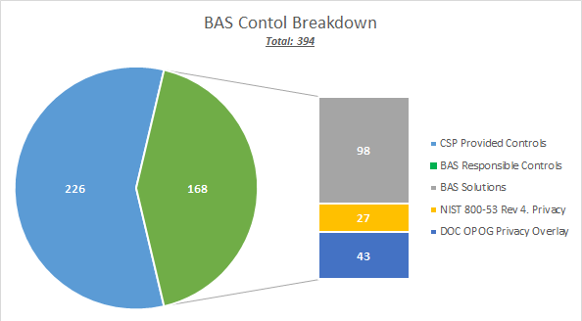
BAS PROGRAM TABLE TALK
What this means for bas
  FedRAMP Authorized CSPs still provides a high-level assurance to federal systems
    Reduces amount of controls to implement (IaaS > PaaS > SaaS)
    Does not eliminate need for the federal ATO process
    BAS is still responsible, either fully or shared, for the implementation of 168 controls
      Independently assessed
      Receives ATO from responsible Department or Agency
  DOC requires all cloud systems be FedRAMP Compliant
  Systems with PII need to comply with the OPOG* Privacy Overlay
  BAS will implement additional controls outside of a normal NIST 800-53 Rev. 4 Moderate control baseline and develop additional processes and requirements
SaaS
Platform
Security
* Office of Privacy and Open Government
8
Notes:
Michelle/Jon
FedRAMP Authorized CSPs do provide a high-level assurance to federal systems and reduce the amount of controls a system is responsible to implement (IaaS > PaaS > SaaS), it does not eliminate the need for the federal ATO process. Controls would still need to be implemented (BAS ~160), independently assessed, and receive an ATO from the responsible Department or Agency.
DOC currently requires all cloud systems to be FedRAMP Compliant, and systems with PII to comply with the OPOG Privacy Overlay. This requires BAS to implement additional controls outside of a normal NIST 800-53 Rev. 4 Moderate control baseline and develop additional processes and requirements.

Slide 9
BAS PROGRAM TABLE TALK
Initial ato
Solution | FedRAMP Package | Use
Enterprise Data Warehouse / Business Intelligence (EDW/BI) | Accenture Insights Platform (AIP) Platform as a Service (PaaS) [JAB P-ATO] | Enterprise Data Warehouse/Business Intelligence and Ad Hoc Reporting
ServiceNow | ServiceNow Government Community Cloud Software as a Service (SaaS) [JAB- ATO] | BAS ITSM and Future Single Sign-On (SSO) Portal
Xtended Detection and Response (XDR) | Accenture XDR for Government Software as a Service (SaaS) [Agency ATO] | Managed Security Detection, Alerting, Reporting & Analytics
Post-ATO
Move to Continuous
Monitoring phase
produce metrics and dashboard reports
Assessment and ATO
CoalFire will conduct Assessment and Pen Test
compile ato Package
submit documentation to fedramp
PRE-ATO
Review FedRAMP Packages
develop security documentation
collect evidence to support Control implementation
document risk acceptances and POAMs
APRIL 2021 – BEYOND*
JANUARY 2021 – APRIL 2021*
SaaS
Platform
Security
APRIL 2020 – DECEMBER 2020*
*Proposed Timeline; Subject to Change
9
Notes:
Michelle and Jon
BAS Security team has received initial FedRAMP Packages and is reviewing for responsible controls and gaps between DOC polices, FedRAMP requirements, and OPOG controls.
Security team will provide Tech Arch and Development teams requirements to ensure secure development for solutions.
During this time, Security team will develop all necessary procedure documents and security documentation (System Security Plan, Privacy Impact Assessment, Security Categorization, etc.)
As the EDW/BI solutions approaches Go-Live, Security team will collect evidence supporting implementation and document any risk acceptances and POAMs.
CoalFire will complete the initial independent assessment, testing all applicable controls and review CSP packages for any outstanding gaps. CoalFire will also complete a penetration test to assess the technical security implementations for BAS
Security team will review all findings and compile the ATO package and briefing documentation to provide to Authorizing Officials, System Owner, and Information Technology Security Officer.
Upon receiving a successful ATO, the ATO letter for BAS will be submitted to the FedRAMP PMO. This will list Department of Commerce as an “Agency using this service” on the FedRAMP Marketplace for each of the CSPs. This will also give the BAS Security team perpetual access to the FedRAMP Authorization Packages to receive annual review and regular POAM updates.

Slide 10
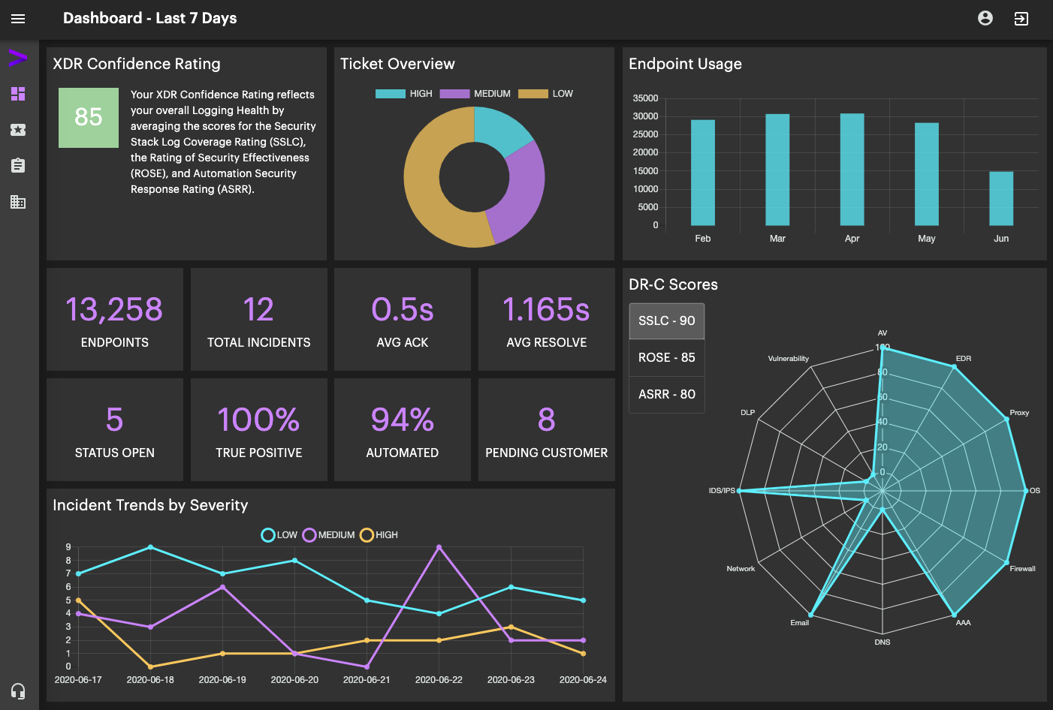
BAS PROGRAM TABLE TALK
ACCENTURE XDR
Real-time, managed security service for event management, alerting, security monitoring, and threat intelligences
Helps identify suspicious behavior and aligns the solution to specific needs
Using industry-leading tools, will allow BAS to meet or exceed compliance standards and requirements through rapid response and remediation
Will provide a holistic view across all BAS solutions and assist the BAS Security team, DOC, and CSPs to review audit logs and alerts and respond in a timely fashion
At a Glance:
FedRAMP authorized (moderate)
SOC is staffed 24x7x365
Customer Portal provides real-time visibility
Real-time updates of security posture and core metrics
Overview of open investigations
Detailed look at security posture with suggested improvements
Contact information and form
SaaS
Platform
Security
10
Notes:
Michelle/Jon
Accenture’s Xtended Detection & Response (XDR) is a real-time, FedRAMP Authorized, managed security service providing event management, alerting, security monitoring, and threat intelligences into an end-to-end consolidated platform for BAS.
XDR is a purpose-built set of capabilities and tools for rapid cyber defense that helps identify suspicious behavior and align the solution to specific needs, including compliance requirements and environment monitoring. XDR will use industry-leading tools like Splunk, Phantom, and iDefense to continuously monitor BAS at a level that meets or exceeds compliance standards and requirements through rapid response and remediation.
This managed security service will provide a holistic view across all BAS solutions and assist the BAS Security team, DOC, and CSPs to review audit logs and alerts and respond in a timely fashion.

Slide 11
Q&A
Notes:
Andy

Slide 12
BAS PROGRAM TABLE TALK
WE NEED YOUR INPUT
Return to
www.menti.com
Enter the passcode (if not already entered)
15 56 26 3
Answer the question that appears
12
Notes:
Mike

Slide 13
BAS PROGRAM TABLE TALK
HOW TO GET INVOLVED
Questions/Concerns/Feedback? Want to be involved?
Contact BAS Project:
  BASProject@doc.gov
Need more information? Visit us online at:
  https://www.commerce.gov/ofm/bas-homepage/business-applications-solution-bas
13
Notes:
Andy

