Slide 1
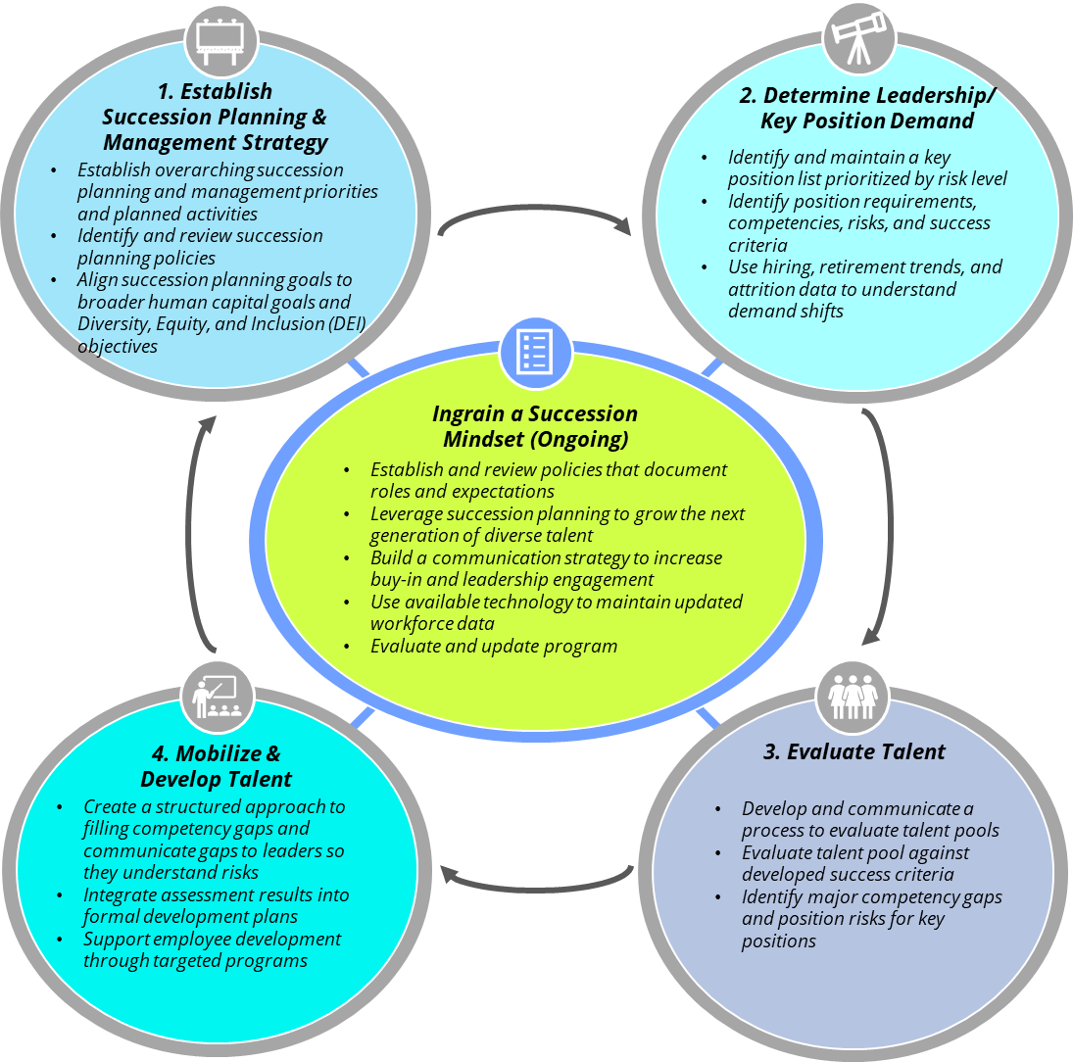
Department of Commerce (DOC) Succession Planning & Management Framework
The DOC Succession Planning and Management maturity framework is used to guide the planning, execution, and evaluation of talent management and succession planning activities. It sets a framework to efficiently and effectively recruit, develop, retain and deploy the workforce, and build a pipeline of talent for leadership, Mission Critical Occupations (MCO), and key positions for current and future missions. The model enables the organization to set a succession planning and management vision, document leadership requirements and human capital gaps, create and implement strategies to enhance identified strengths and address identified gaps, and measure progress against identified success metrics.
1
Notes:
Succession planning and management is an ongoing strategic process by which DOC bureaus identify, develop, and secure talent to build a talent pool that ensures the continuity of DOC’s mission through leadership and workforce shifts.
Succession planning and management activities focus on building a pipeline of talent for leadership and/or identified key positions.
The adoption of succession planning, and management activities will enable more effective human resources management, strategic human capital planning, and mission delivery.
Organizations are encouraged to prioritize activities based on their specific talent management and succession planning resources and priorities.
The Department of commerce implemented this maturity model in 2021 in the Office of the Secretary we conducted interviews and surveys to (1) assess future organizational leadership demands, (2) identify critical Senior Executive Service (SES) skillsets, and (3) identify necessary experience and talent pipelines for OS leadership positions. We then conducted a talent competency assessment using the Determine Leadership Demand (DLD) data as a baseline to identify human capital needs and development opportunities in the organization. This information feed into the Mobilize and Develop Talent. In this phase Mobilize and Develop Leaders phase, which will focus on developing and implementing appropriate strategies to close identified gaps from the Evaluate Talent phase. We are in the process of identifying office-specific strategies to close identified gaps and incorporating strategies for learning, training, development, and the transfer of knowledge into your succession planning and management.

